Slide 1
Fed-IP
Assessor Training:
Module 2
The Assessor Role &
Special Considerations
Notes:
1

Slide 2
The value of our assessors
The assessor role is an important one which supports BCS primary purpose to “Make IT Good For Society”
BCS has selected its assessors based on their competence, experience, specialist areas and the relevant skills which were demonstrated in their applications.
BCS has a formal recognition policy to recognise the valuable work of our assessors.

Slide 3
The role
The assessor role is required to undertake:
Written application reviews, telephone discussions, interviews
Your availability will be requested every 4-6 weeks via email and this is used to allocate applications for your assessment.
Applications are allocated on Mondays – to your assessor named folder in SharePoint.
Turnaround time to complete your assessments and upload them back to your named folder in SharePoint is 7 days.
Let us know if you’re unable to complete the reviews within the 7 days – we can reallocate if necessary.

Slide 4
BCS’s role
BCS aims to provide support, information, and responses to any and all queries from its assessors by:
Ensuring processes and procedures support what we expect our assessors to do.
Sharing best practise & keeping you connected with your fellow assessors.
Providing the tools to do the job and ensuring assessors feel confident in using them.
GoToMeeting is our remote online interview tool – let us know if you would like a test session to feel more confident using it – our Assessment team will be happy to run through it with you. Email us at assessments@bcs.uk
SharePoint is our secure file transfer tool – let us know if you want any help understanding the file structure and the way to use it. Email us as above.

Slide 5
BCS’s role
BCS is responsible for ensuring:
Continuing best practise & quality of assessments
Compliance to standards
Carries out quarterly quality assurance checks. Where appropriate, feedback is shared with assessors. This may result in changes to procedures or improvements to guidance or identifying where more assessor training/mentoring is needed.
Reviews applicant Appeals. As an assessor it’s important you give good quality feedback with constructive advice on career progression so that applicants understand why they have failed and what they can do to qualify in the future. A lack of understanding on the applicant’s part may result in them appealing your decision.

Slide 6
Assessor network
Our assessors are a group of people working remotely, aiming to consistently apply a common and rigorous standard.
BCS understands the challenges this presents and seeks to promote the value and benefits of connecting with your fellow assessors:
Online regular assessor Linkup sessions
Regular Assessor Newsletters
LinkedIn Assessor Group – send us a request to join.
Face to Face Assessor Forum at BCS London office when appropriate
Aim to facilitate mentoring between assessors

Slide 7
Who & what supports the assessor role?
Service Assessment Team is your “Go To” place for any and all questions. Email: assessments@bcs.uk
Service Delivery Team deal with the day to day handling of applications; uploading applications for your review to your folder in SharePoint and downloading your completed assessments and processing next steps for the application.
SharePoint is the online secure file transfer tool that is used to share applications with our assessors. It’s also the place where you can find all the necessary guidance and templates.
GoToMeeting is the remote online interview tool used for TRIs and PRIs

Slide 8
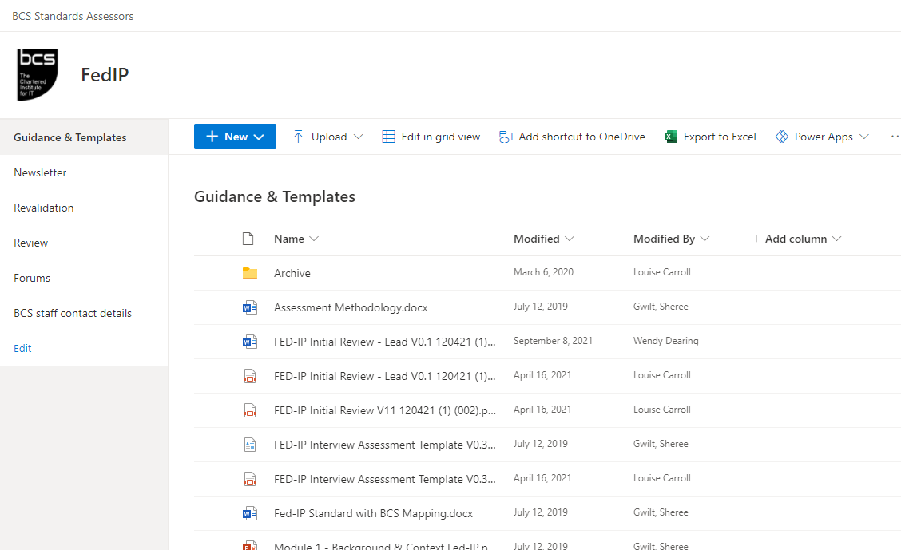
Assessor Tools - SharePoint
You will receive an invitation to join the SharePoint workspace – Here is a screenshot of where you will find the Guidance and templates
Notes:
8

Slide 9
SharePoint
Applications for your review are uploaded to your named folder. This is the folder to which you will also upload your completed assessments.
Notes:
9

Slide 10
Online Interviews
Interviews are held online using GoToMeeting. Here’s a link where you can find out more about the GoToMeeting tool:
http://support.citrixonline.com/GoToMeeting
You can request a run through session with the Service Assessment (SA) Team, prior to your first scheduled interview.
Have a play and learn how to use it
Make sure you have a webcam, good headset and Internet connection
Link up with your fellow assessor to prepare in good time prior to the interview
The SA team will notify which assessor will act as the GoToMeeting host – this will always be an experienced assessor. The host will record the interview.
Notes:
10

Slide 11
Special Considerations
Data Handling
Conflicts of Interests
Integrity and Professionalism
Independence & Impartiality

Slide 12
Data Handling – DPA
For your own protection we request that you do not download any application documents or pint off any hard copies.
Remove and destroy personal information from your system once the process is complete
Keep all assessment information secure, it should only be accessible by you e.g. NOT on shared family computers
Do not use Cloud systems eg. Dropbox
Notes:
12

Slide 13
Data Handling – DPA
Be aware of the way in which you record your assessment as applicants have the right to request access to all documentation relating to their application via a Subject Access Request (SAR).
Be careful with the words you choose to record on your assessment.
Be sure not to enter subjective or personal comments – the assessment must relate to the evidence presented.
Ensure your comments and feedback are professional and constructive.
Notes:
13

Slide 14
Integrity & Professional competence
Remember professional integrity commitments as a BCS member
Professional Competence and Integrity
You must:
a) only undertake to do work or provide a service that is within your professional competence.
b) respect and value alternative viewpoints and, seek, accept and offer honest criticisms of work.
c) avoid injuring others, their property, reputation, or employment by false or malicious or negligent action or inaction.
d) reject and will not make any offer of bribery or unethical inducement.
Notes:
14

Slide 15
Conflict of Interest & NDA
Assessors are required to sign a
DSA Data Sharing Agreement
Assessors must declare any obvious conflicts of interest with applicants
Don’t assess or interview people you know well eg. people who you may be familiar with at work, work colleagues,.
Don’t assess or interview people who could have grounds to claim a conflict of interest
Notes:
15

Slide 16
Independence & Impartiality
The final decision lies with BCS
BCS have quality assurance processes in place through the MCP (Membership & Certification Panel) to ensure reliability and validity of assessments.
It is essential that you remain impartial throughout any assessment and treat all information provided to you confidentially.
Notes:
16

