Slide 1
Fed-IP
Assessor Training:
Module 3
Assessing an application for Fed-IP
Notes:
1

Slide 2
The Fed-IP application & assessment
This module covers:
Applying for Fed-IP
What does the applicant submit?
The Initial Review Assessment
How to approach your assessment
The interview assessment

Slide 3
Applying for Fed-IP
Fed-IP applicants may or may not be BCS members.
BCS membership grades equate to different Fed-IP levels (see module 1- Slide 6 of the assessor training & table below)
Note “Leading Practitioner” equates to Fellowship grade, this will be assessed outside of the standard Fed-IP route.

Slide 4
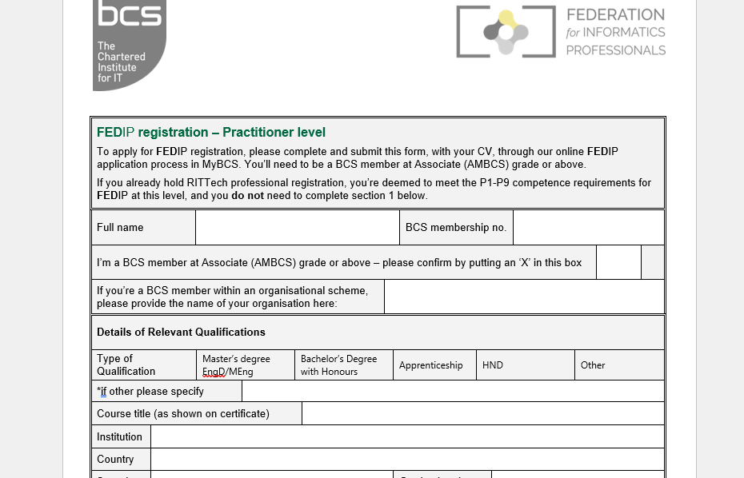
What does the applicant submit?
BCS members applying, you should see the completed form (depending what level) below in the applicant’s SharePoint folder (mandatory), along with the other evidence docs, eg. CV (mandatory), org charts, qualifications, additional info (optional) :

Slide 5
The initial review assessment
The applicant enters their evidence to the application form to demonstrate how they meet the criteria for the Fed-IP level standard for which they are applying.
The assessor completes the Fed-IP Initial Review Assessment template available in the Fed-IP SharePoint workspace.
“Assessor Feedback”. It is in each of these sections that you enter your assessment comments.
You will also notice further down the form a section for you to enter the outcome of your assessment.

Slide 6
The initial review assessment
Service Delivery Team will upload the application form and any additional evidence to the SharePoint Fed-IP workspace and you will receive notification that files have been allocated for your review including:
Curriculum Vitae
Experiential evidence supplied as part of BCS membership application
The assessment process requires 2 x assessors together to collaboratively assess the evidence and agree the outcome and sign off together before agreeing who will finish the report and upload to Huddle.
IMPORTANT: Until we have full compliment of assessors, we may need to manage this part of the process via individual rather than collaborative assessment approach. You will receive confirmation from the SD team if you are expected to carry out an assessment with a fellow assessor and agree a final report between you.

Slide 7
How to approach your assessment
Referring to the applicant’s evidence, apply the “Assessment Methodology” Guidance Notes using the Star technique as described.
Look for evidence of how the applicant has demonstrated what they have personally done. Be careful to understand distinction between “we” and “I” statements and look for demonstration of how the applicant has personally met the requirements of the standard.
Ensure the comments you enter to the Assessor feedback section are sufficiently clear and concise such that they can be shared directly with the applicant.
For “further information” requests, be very clear about where the gaps in evidence exist and what further demonstration needs to be provided by the applicant, being sure to link this directly to the standard requirements.

Slide 8
The interview assessment
If the application gives insufficient evidence of meeting the requirements, the assessment process allows the assessor the option to invite the applicant to an interview. The interview is carried out with 2 assessors.
The interview will take place via GoToMeeting.
2 weeks in advance of the interview date you will receive an email confirmation with the interview details including the GoToMeeting link. (Your interview availability would have been requested via email)
Before starting the interview proper:
Read through the documentation in SharePoint. The Service Delivery team will share application documentation with you in advance of the interview.
Link up with your fellow assessor to agree approach and clarify areas of questioning as highlighted by the initial review assessment. Check the documentation and the feedback the applicant received following their initial review, focus on these areas in the interview.
Carry out a photo ID check before starting the interview.
Put the applicant at ease; briefly introduce yourselves and give a brief outline of your relevant experience.

Slide 9
The interview assessment
Inform the applicant that the interview will be recorded.
Ask the applicant if they are happy to proceed – see the question on the interview template →
Start the interview assessment by following the interview assessment template questions prompts – The interview template can be found in the SharePoint Fed-IP workspace in the folder entitled “Assessor Guidance & Templates”
Ask open questions and follow the STAR Technique outlined in the Assessment Methodology guidance available in your SharePoint workspace.
Inform the applicant that BCS will notify them of the outcome within 10 working days.
Agree the content of the interview report with your fellow assessor.
Upload your completed interview report to the interview folder in SharePoint.

