Slide 1

Welcome Everyone!
BCS Women Webinar Series
bcs.org

Slide 2


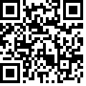
Introduction and a bit about me!
My names: Claire Mironik
I am the Change and Test Manager at Aston University Digital Services
Passionate about supporting inclusion, diversity, and progression in technology
I am a member of the fantastic BCS Women Committee
I want to promote more gender equality across the sector
Let's connect!
bcs.org

Slide 3





House Keeping
Keep Microphone muted
Use the chat for any questions
This session will be a recorded webinar
Lets be respectful and inclusive
Any technical issues please let me know

Slide 4
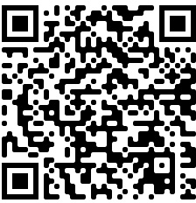
About BCS Women
We are a specialist group of the BCS, The Chartered Institute for IT
Led by volunteers united by a shared purpose to inspire, empower, build and thrive in IT careers by:
  Providing community
  Networking opportunities
  Support for all women working in IT around the world – including transgender, non-binary and intersex people
We welcome men as advocates and allies in
building a truly inclusive technology industry.
And it’s also about having fun!
Inspiring,
Empowering,
Building and
Thriving in IT
Careers
bcs.org

Slide 5
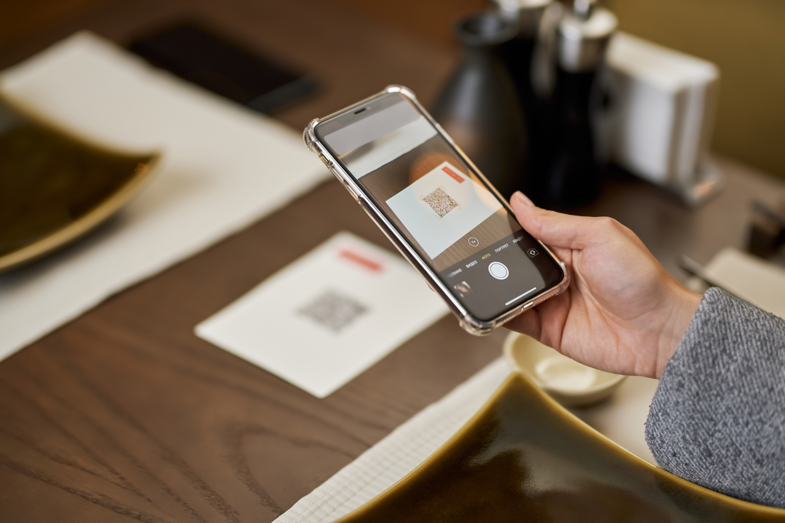
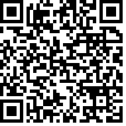
Thinking about joining the BCS?

Slide 6
Lunch and Learn Series
We will be holding a series of lunch and learns
Introduction to the Reed Women in Tech Network Every event features a tech theme.
Let's learn and connect before the Women in Tech meetup! Friendly session to explore and ask
Pass the torch to Kevin Dainty!

