Slide 1
Chartered Week 2025 Briefing

Slide 2
Welcome to Chartered Week!
Contents:​
Overview of Chartered Week
Year 1 aims
Ways to get involved​
Closer look at the toolkit​
Key asks​
Next steps​
Q&A
Notes:
Chartered Week 2025 is a unique opportunity to celebrate trusted professionals and raise awareness of the value they bring to society. This deck covers the key details, resources, and ways you can get involved to make this initiative a success.

Slide 3
Overview of Chartered Week
How the initiative came about
Theme for 2025: Celebrating Trusted Professionals​
Shared challenges and goals across sectors
Notes:
Chartered Week is a new national awareness week bringing people and organisations together to shine a light on professional registration and its impact in society today.
Around seven or eight months ago, we began discussing this potential initiative with our current President, Alastair Revell, who is a passionate champion and advocate for professional standards and chartered status. With his enthusiasm and support, we shared the idea with the various Chartered bodies we collaborate with or encounter at conferences and events. It became clear very quickly that there was significant enthusiasm and support for the concept, and we wanted to create something that all the chartered professions could collectively support and champion. We identified three key objectives we hoped to achieve: • Celebrate chartered professionals and their impact on public trust. • Educate others on the role of chartered status in setting high standards of ethics, competence, and leadership. • Advocate for the value of becoming chartered and encourage others to explore registration pathways. With that in mind, we took on the challenge of establishing a new awareness and celebration week on the calendar. For this first year, we felt a theme would be helpful. The first year’s theme of “Celebrating Trusted Professionals” recognises the individuals and organisations like yourselves that demonstrate the long-term value of Chartership in modern society. – and we hope, keeps things easy and simple for year one. While we acknowledge that every professional body, association, institute etc is different, there are shared elements of what chartered is and means that unite us—such as our collective commitment to doing things right and leading the way in our professions, sectors and industries. Our hope is that by coming together for Chartered Week, we demonstrate how much stronger we are as a collective, amplifying our message and impact.

Slide 4
Year 1 aims
Launch and establish Chartered Week as a scalable, recognisable campaign
Unite Chartered bodies across sectors
Celebrate the impact and value of Chartered professionals
Use branded assets, hashtags and messaging to increase awareness and understanding
Notes:
In this first year, our priority is to establish Chartered Week as a recognisable and impactful campaign.
We’re focusing on:
Building a scalable awareness week that unites Chartered bodies across sectors – we’re building a Chartered Week Alliance and have over 30 Chartered bodies who’ve pledged their support for the week. Together we’ll be creating a unified voice to celebrate and promote the importance of Chartered status.
Celebrating the impact and value of Chartered professionals – encouraging employers, chartered bodies and chartered or aspiring chartered professionals to showcase their chartered stories and careers - highlighting the positive impact Chartered professionals have on businesses, communities, and society.
Using shared branding, hashtags, and messaging to create a cohesive voice and help build awareness and understanding of what it means to be Chartered, focusing on the unique value trusted Chartered professionals bring to their fields.
Encouraging collaboration to amplify the message and ensure a successful launch

Slide 5
Ways to get involved
#EmployingChartered
Kickstart the conversation and celebrate your Chartered professionals on your social channels – using the tailor-made posts!
Host internal and external events (e.g. lunch & learns, webinars)
Highlight the professionalism and performance of your Chartered talent in newsletters and communications
Call out your Chartered colleagues and the routes to registration on your company Intranet
Notes:
There are many ways to get involved…
Some examples might be
Using the branded assets and hashtags to create a few social posts celebrating your chartered professionals
Other ideas might be hosting internal & external events such as webinars or lunch and learns to educate customers, partners and staff on the vital role Chartership plays in society
Perhaps you could highlight your Chartered professionals and support for Chartered Week in your customer newsletters to showcase your commitment to professionalism
These are just a few ideas to get started! So, let’s take a closer look at the Chartered Week website and toolkit.

Slide 6
Closer look at the toolkit
Logos, badges, templates and social media assets
Tailored employer newsletter and intranet copy
charteredweek.uk
Notes:
You’ll see that the resources in the toolkit are there for you to download.
There are:
Logos, banners, and digital badges
Pre-written social media posts and templates
Copy for your customer newsletters or staff intranet
The logos can be displayed on your website, social pages, digital materials
There are templates for social media posts especially for employers to use
As an Employer there are assets designed for you, but we’d also encourage you to encourage your Chartered professionals and partners in your network to help with wider participation
The email header can be used in relevant comms or as an email footer to show your organisation’s support
The digital badges are a nice way to support the awareness week and could be added to email signatures or social profiles - again there are versions so different people can participate in the week
And there is also pre-written newsletter content which can be tailored as needed to help you showcase your Chartered talent and commitment to professionalism, plus encourage and inspire your teams to explore registration pathways

Slide 7
Key asks
Help create awareness:
- show your support across your social channel using #CharteredWeek and #EmployingChartered
- use the assets in the toolkit for your existing customer and staff communications
Celebrate your Chartered professionals
Collaborate on scaling the campaign for 2026 and beyond
Notes:
To make Chartered Week a success, we need your help.
Help create awareness – just one social post will help to generate awareness, but the more you can share via your different channels and platforms, the bigger the impact and the better the reach the campaign will achieve.
Use the week to celebrate and shout-out your Chartered professionals and the value they bring to your business, customers, society!
And if you’d like us to feature your organisation/ Chartered Professionals during the week, please let your Key Account Manager know
Let’s collaborate to scale this campaign beyond 2025 and make it even bigger next year. We'd love to hear your ideas for scaling Chartered Week for 2026 and beyond!

Slide 8
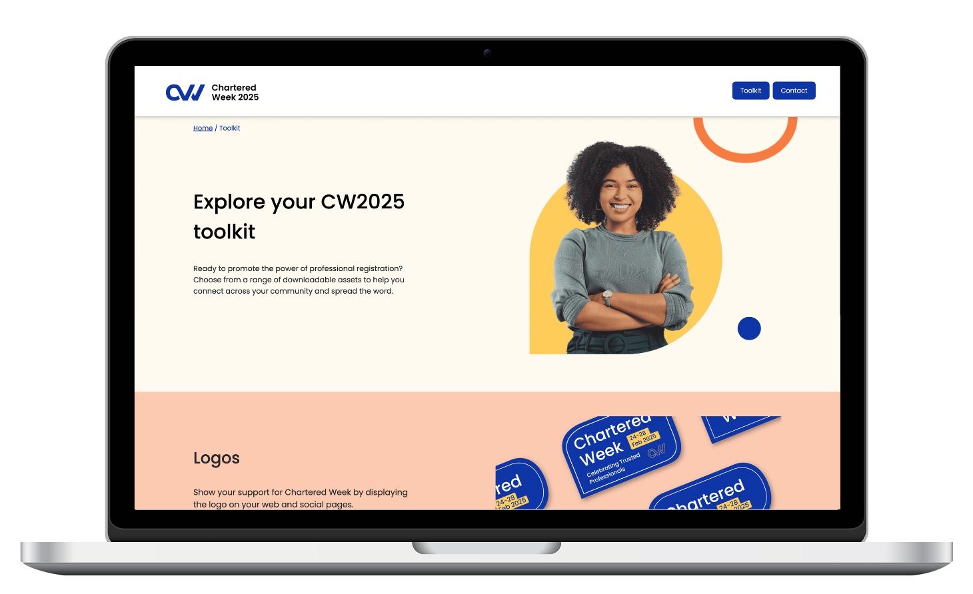
Next steps
Explore the toolkit
Plan participation for February
Join future collaborative efforts
Notes:
Here are the next steps for you to get ready to support the week:
Explore the toolkit and decide how your organisation will participate.
Begin planning your activities for Chartered Week.
Together, I'm sure we can make Chartered Week a landmark event that grows year after year.

Slide 9
Thank you!
Notes:
Thank you for helping to make Chartered Week a success!

