Slide 1
BCS Member Group Treasurers Training
Governance and Treasurer Role
Notes:
Welcome to this tutorial for member group treasurers – in this tutorial we explore BCS governance and the role of the treasurer.

Slide 2

Boards & Committees | BCS Structure
COUNCIL
TRUSTEE BOARD
Influence Board
BCS Academy of Computing
Community Board (CB)
Finance Committee
Fellowship Committee
Early Careers Executive
Nominations Committee
Risk, Audit and Finance Committee
Registration Standards Committee
Renumeration Committee
Health & Care Executive
F-TAG (Fellowship Technical Advisory Group)
BCS Community Team and HQ (Swindon)
Community Support Committee (CSC)
Responsible for encouraging best practice;
communication with and between Member Groups;
and support provided to Member Groups.
Member Groups
BRANCHES | SPECIALIST GROUPS | INTERNATIONAL SECTIONS
Notes:
They say it takes a village to raise a child… well that statement is true to BCS as well, we have a wide range of boards and committees supporting the BCS deliver its royal charter and all of the boards and committees are made up of volunteers like yourself.
We are governed by a Board of trustees who set high level strategy. This is supported by an executive staff team who have responsibility for administration and operations of the institute. The trustees also delegate responsibility for some decision making to other governance boards and committees, through Vice Presidents and honorary officers.
Council is an advisory group, made of members who provide a sounding board to trustees and provide an advisory role to the institute. Council is made of members of the institute, with role being elected by either all professional members or some cases by our member groups constituencies.
Reporting to trustee board are 3 strategic boards and 4 committees such as risk audit and finance, which help keep the organisation honest and on track or the remunerations committee who assess appropriate pay of executives. For this session I’ll focus on the strategic board which all member groups are responsible to, Community Board.
Two sub committees help the Community Board to support the delivery of our community: Finance Committee and Community Support Committee. The community support committee has a focus on developing guidance and support for member groups – they are there to engage with group and volunteers and the wider organisation to support best practice and continuous improvement. The finance committee have responsibility for allocation of funding for member groups which has been agreed by Trustees.

Slide 3
Member Groups in the structure
All groups report to and are managed by the Community Board.
The Community Board has 2 sub committees directly related to member group support
  Finance – Responsible to Community Board for member group finances
  Community Support Committee – Responsible for policy, processes and procedure – best practice and guidance.
Community Team/Department (groups@bcs.uk)
  This is your initial point of contact within BCS, they will complete all your administrative needs surrounding your events including raising purchase orders.
Finance Department
  This is the section in BCS that pays all the invoices through out the institute and maintains the day to day accounts for every group. They report the current state of your finances to treasurers monthly.
Notes:
Focussing in on member group finances and how the structure relate:
Trustee board approve the total budget of BCS, including member group finances. Community Board is delegated responsibility as strategic board responsible for member groups, it
Community board has delegated responsibility for member groups, by trustee board, as such all member groups are responsible to community board. Community board has a standing committee responsible for member group finances.
Supporting Community Board and the member groups directly are a team of staff called coordinators – coordinators are your first point of contact for queries relating to your budget.
BCS run all accounts centrally for branches and specialist groups, this is supported by the BCS finance team. If the coordinator is unable to answer your questions, they will work with the finance team to find a resolution.

Slide 4
The role of the Treasurer
The Treasurer must be a professional member of BCS (MBCS/FBCS).
Functions
Responsibility to the local Member Group Committee, Finance Committee and the BCS for the Member Group funds and any other appropriate financial business.
Approves payments and receipts to and from operational budget and receives monthly reports from BCS finance team and liaises as necessary.
Prepares annual budget and potential project funding each year.
Reports at fixed intervals to Member Group Committee.
Notes:
The role of the treasurer – all treasurers must be a professional member of BCS.
They are expected to manage individual groups budgets locally, receiving account, signing off expenses and reporting the budget performance to their committee. The treasurer is also responsible for submitting the group’s budget each year, in collaboration with their committee. As well as submitting additional funding requests.

Slide 5
The role of the Treasurer
Submits income and expenditure statements produced by BCS Finance for the group and to the group’s AGM.
Notifies, through Member Groups Team (groups@bcs.uk), any forecast overspend together with
  (a) the circumstances leading to this position and
  (b) the proposed action plan to resolve the situation.
Notes:
Annually treasures also report on the finances of their member group at their annual general meeting, using the reports provided by the BCS finance team.
Treasurers also should notify the member groups team of any underspends or risk of overspends in their budget – our collective aim is to fully utilise the funds approved by trustee board and so understanding likely underspends will help funds be redistributed to groups with additional spending needs. Whilst groups should not overspend, from time to time this may happen, for instance a chargeable event that doesn’t bring in budgeted income due to ticket sales and expenditure commitments at the point of booking that are unflexible – scenarios like this should be reported to the coordinator team at the earliest opportunity.

Slide 6
BCS Member Group Treasurers Training
Understanding Accounts, Approving Expenses and Payment of Invoices
Notes:
Welcome to this tutorial for member group treasurers – in this tutorial we will help you to understand your accounts, expense and payment processes.

Slide 7
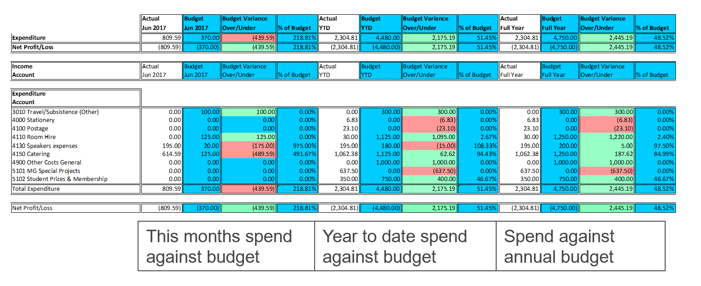
Understanding the monthly reports
Each Month the Treasurer and Chair receives a report from BCS Finance detailing the current state of the groups finances.
The Spend against annual budget is the most important.
Notes:
Each month the treasurer and chair receives a report from the BCS finance team, the front sheet consists with an overview of the budget.
The top section provides a view of expenditure and net profit or loss.
The section below that documents the income of the group.
Below that you can have a view of expenditure against specific items
The bottom section details the net budget.
Items on the left cover month spend/income against budget – this is forecast of what you expected to spend during the month that the accounts are issued.
In the middle we report on year to date - a cumulate budget of the previous months and current months.
Month and Year to date will help you track your expenditure and ensure you maximise your budget throughout the year, avoiding running out of funds prematurely.
Finally, perhaps most importantly is spend against annual budget – paying attention to this colloumn will help you understand your total available budget.

Slide 8
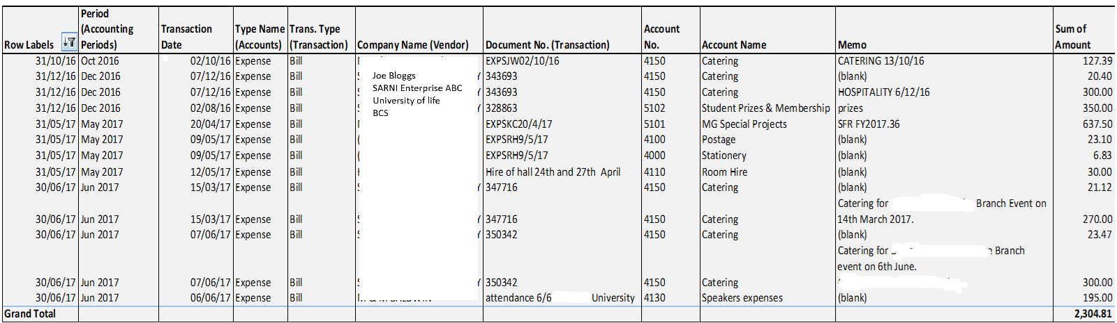
Understanding the monthly report
There is also a second tab which itemises the current income and expenditure.
A separate tab is available for those groups that have chargeable transactions such as conferences.
Notes:
On a separate excel sheet you will also be provided with a list of transactions, pay attention to this to ensure expenditure or income has been appropriately attributed to your group.

Slide 9
How to Handle Expenses Claims
There are detailed notes on the expense form and financial guidelines documenting the expense process however, for this session please note that:
  Expenses will be reimbursed to volunteers and staff providing that:
    They are budgeted for and prior approval obtained
    They were incurred whilst undertaking activities of BCS
    They were reasonable
    Relevant receipts/tickets (or copies) are attached to the claim form.
    Expenses will not be paid to non BCS members unless prior agreement has been sought from the Finance Committee
Full details are on the volunteer resources page
https://www.bcs.org/membership-and-registrations/member-communities/bcs-volunteer-hub/volunteer-resources/finance-budgeting-and-managing-groups/
Notes:
Next up, expenses.
There are detailed notes on the expense form and financial guidelines documenting the expense process however, for this session please note that:
Expenses will be reimbursed to volunteers and staff providing that:
They are budgeted for and prior approval obtained
They were incurred whilst undertaking activities of BCS
They were reasonable
Relevant receipts/tickets (or copies) are attached to the claim form.
Expenses will not be paid to non BCS members unless prior agreement has been sought from the Finance Committee

Slide 10
Purchase Orders and Invoices
There is one central account all expenditure for the group has to be paid via finance.
We can only pay invoices where there is a contract in place and the supplier is set up
When a group identifies a budgeted expenditure, ( e.g. room hire) your group, advise your BCS coordinator so they can progress a contract with the supplier and BCS, BCS need to know what its for, the value, and the supplier details. BCS will review the contract and raise the purchase order(PO) and provide the supplier with the PO number for the suppliers invoice… Ideally this process will start no later than a month before the expenditure is needed to allow contract signing, supplier set up and PO creation.
When the invoice is raised it should be sent directly to finance with the Groups Name, Purchase Order Reference, Account Code https://www.bcs.org/membership-and-registrations/member-communities/bcs-volunteer-hub/volunteer-resources/finance-budgeting-and-managing-groups/ and SFR Reference number (if applicable) . They will pay it against the purchase order.
Notes:
All expenditure and income financial processing is managed by BCS on a central account.
It is BCS financial policy that invoices may only be paid where a contract is in place between BCS and the supplier and that the supplier has submitted relevant information to be created as a supplier in the BCS payment platform, where appropriate also being vetted by our compliance team.
As an example, if a group requires a venue to be hired for a meeting, once a preferred venue has been identified along with any other requirements for hire such as dates and costs you should introduce the supplier to your coordinator to begin the contractual process. BCS will then put a contractual agreement in place via its legal team, this then triggers a process for supplier creation and issuing of purchase orders via our payments system. Invoices should be sent directly to the BCS finance team.
This process takes time, we recommend a minimum of one month to allow this process to take place – so plan ahead.

Slide 11
BCS Member Group Treasurers Training
Additional Funding Requests
Notes:
Welcome to this tutorial for member group treasurers – in this tutorial we will help you to understand how to request additional funds.

Slide 12
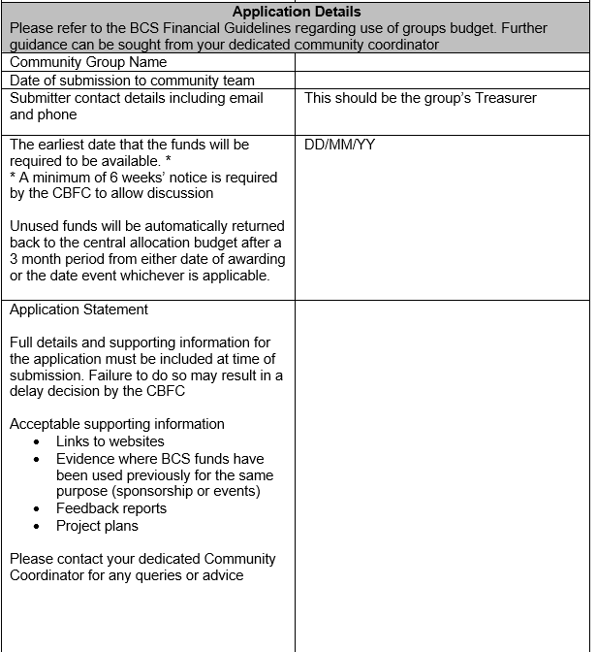
How To Fill in the Supplementary
Funding Request (SFR) part 1
SFR’s are a way of requesting extra funding when you have additional non budgeted activity taking place or an activity outside of your member events programme
They require the group to complete an SFR request form and submit to Finance Committee
This section asks you document what the activity is and when the funds are required.
Notes:
Each year we allocate groups a basic allocation to support frequent activities like branch or specialist group meetings, some groups also carry out projects which have more variables and potential risk, run larger conferences or sponsor third party initiatives.
Sometimes, groups also need a bit more money due to wanting to run more regular activities than their allocation allows.
For these reasons we have a process called the supplementary funding process. Member groups can request additional funding by completing a supplementary funding request which documents the background to what the funding is for, how it supports our purpose and how and when funds are required – this information is reviewed by the finance committee who meet monthly, the chair of the committee also has the ability to sing off lower value urgent requests.

Slide 13
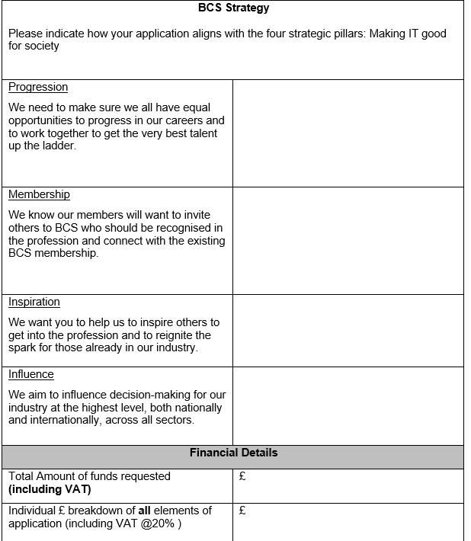
How To Fill in the Supplementary
Funding Request (SFR) part 2
This section of the SFR submission concentrates on the how the request supports the BCS strategy and the benefits the event will bring to BCS in the long term
It also documents the total funds being requested.
A similar but separate form is available for sponsoring third party events (hackathons, career fairs etc).
Notes:
In part two, you can see that you are invited to document how the application supports BCS strategy.
Groups should plan to submit an SFR at least 6 weeks prior to the activity, and 8 weeks prior if contracts are required to support payments.
SFRs allow a route for member groups to increase their funds through-out the year and enable the finance committee to fully utilise the funds made available to it.

Slide 14
SFR Feedback Form
If successful, following the expenditure you are asked to submit feedback on what the expenditure achieved. This helps us to understand how BCS funds are creating an impact and we can also refer back to it if similar requests are submitted in future.
Notes:
Lastly if successful, you will be invited to provide feedback on the funded activity. This feedback will help BCS to understand what its funding has achieved and also be used as a reference point for considering future applications.

Slide 15
BCS Member Group Treasurers Training
Submitting Your Annual Budget
Notes:
Welcome to this tutorial for member group treasurers – in this tutorial we will help you to understand how submit your annual budget

Slide 16
How to complete the Annual Budget bid for your group
The Financial year ends on the 31st August.
You are required to prepare a budget in February/March to say what you require for the next financial year.
You will receive a budget pack to do this.
There are 3 sections
  The budget bid
  The reasoning behind the bid
  Costings for any Income generated event
When reviewing the budget we will consider your track history of expenditure and impact of expenditure in supporting the royal charter.
Notes:
The BCS financial year runs from September to 31 August.
As part of this process BCS receives annual budget requests from all of its member groups, submitted by group treasurers. As you can imagine this is a large undertaking to review each submission, compile a total member group budget and then gain approval from our trustees. Therefore the budget process runs between February and July prior to a new financial year in September.
In February/ March Chairs and Treasurers will be sent a budget pack, this will document any information you are required to submit and relevant deadlines for the budget process, as well as any changes to financial guidelines or principles to budget allocations. There are three main sections to a budget bid:
The overall budget, income and expenditure against indidual items and months.
Reasoning behind the bid and how it supports the interests of the institute
More comprehensive information to support income generating events or high expenditure

Slide 17
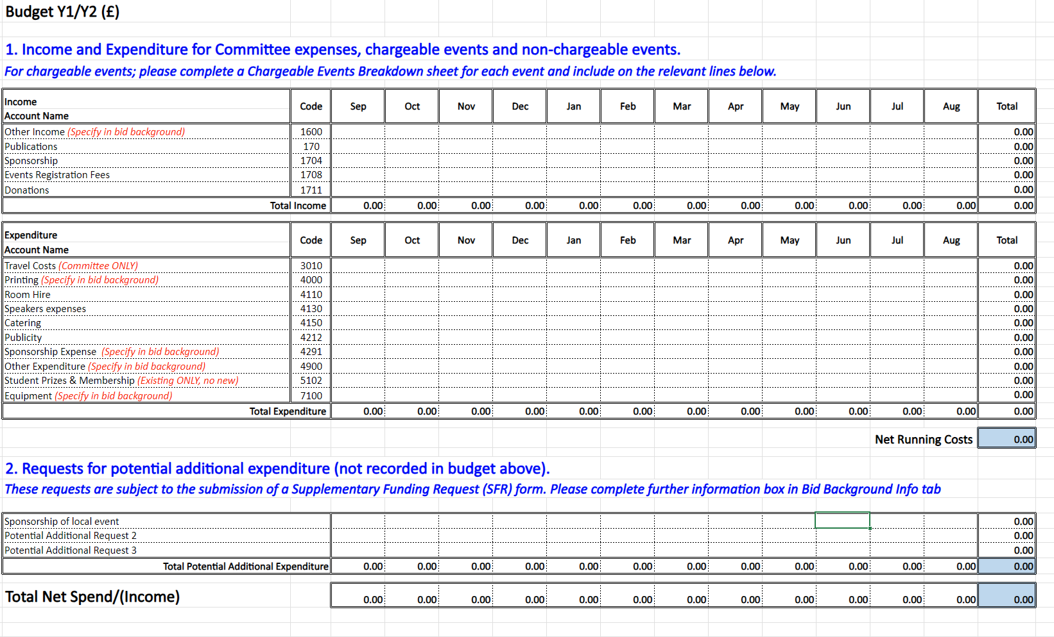
The Budget Bid
Notes:
This is an example budget:
The top section invites you to enter any income such as sponsorships, publications, event registrations.
The middle section invites you to budget for expenditure, as you can see there are set cost items to put budget against – if the item isn’t listed please add to other expenditure and later in the form you will be asked to document what the ‘Other expenditure’ consists off.
Lastly you will be asked to document any foreseen Supplementary Funding requests – for instance sponsoring a local hackathon or running a conference

Slide 18
Background and Income costings
Background
  This section is designed to explain why you have asked for the funds in the budget, why there are changes to previous years and any other information to help with your bid.
  Because Finance Committee have well over 100 bids to deal with it helps us greatly if this section is filled in.
Chargeable event breakdown.
  This allows you to specify in detail what income and costs you have for a chargeable event.
  NOTE If you use BCS London for your meetings then room hire is free.
  HOWEVER if you are costing for a chargeable event then it must be accounted for.
Notes:
Background
This section is designed to explain why you have asked for the funds in the budget, why there are changes to previous years and any other information to help with your bid.
Because Finance Committee have well over 100 bids to deal with it helps us greatly if this section is filled in.
Chargeable event breakdown.
This allows you to specify in detail what income and costs you have for a chargeable event.
NOTE If you use BCS London for your meetings then room hire is free.
HOWEVER if you are costing for a chargeable event then it must be accounted for.
To support your budget bid, you will also be provided with a budget overview form to explain how the budget supports BCS strategy and royal charter.

Slide 19
Roll Over Funds
Rollover funding allows you to carry forward surpluses from chargeable events for up to 2 years.
You still need an SFR to spend rollover but Finance Committee is more flexible on it uses.
Potential Rollover is shown on your monthly statement.
NOTE If you have funds left in your normal budget at the end of the year this is NOT rollover and therefore is returned to the Institute.
Notes:
Finally, in some instances member groups generate a surplus from events – this surplus can be held for up to two years. This is called roll over funding.
Roll over funds will be allocated against your group and you will be invited to submit SFR requests to access the funds
Roll over is shown in your monthly statements.
The last thing to note is that roll over is not the same as unspent budget – if a group has unspent budget at the end of the year it is returned to the institute – if you forecast underspend mid year, notify your coordinator so that we can make that underspend available to groups with additional funding needs

