Slide 1
CBFC Budget Submission Template Guidance

Slide 2
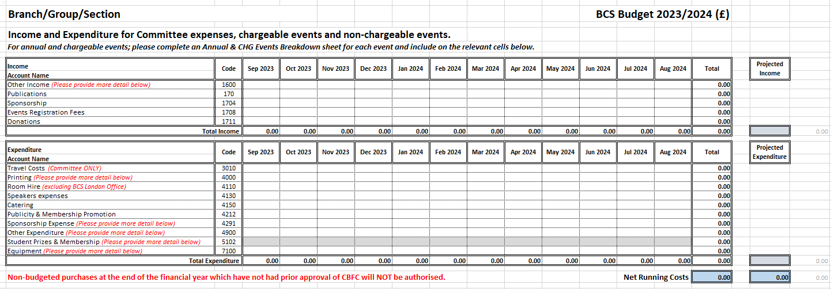
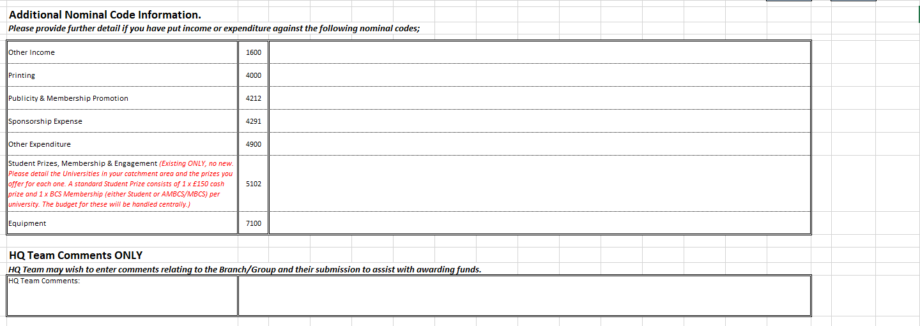
Tab 1 – Budget Request Summary Page
The budget template is made up of 3 main tabs – not all of these may be applicable to your Branch/Group/Section. If you require further assistance, please contact the Community Groups Team
Unless already showing, select your Branch/Group/Section from the drop-down box.
Enter any income you expect to receive and any expenditure you expect to incur in the relevant months, If this relates to a chargeable event, please ensure you have filled out a Chargeable Events Breakdown tab for each event, and also include the figure on this front sheet.
Your figures should include VAT at the current rate of 20%
Please include details of any existing Student Prizes (the budget for Branch prizes this will be held centrally, so the Spreadsheet will not include these in your budget bid).
Some nominal code lines request additional information – please include this information here.

Slide 3
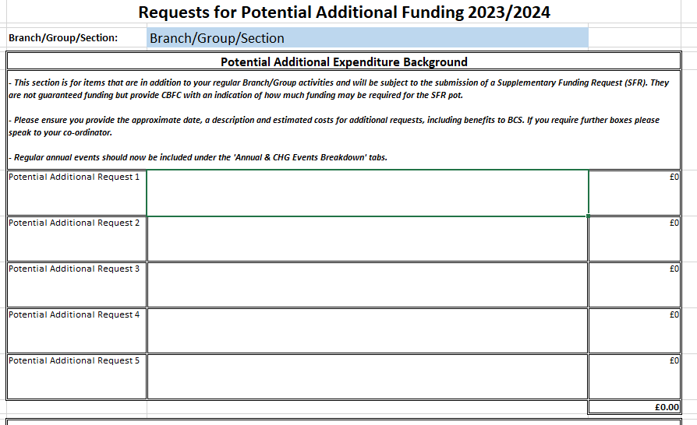
Tab 2 – Potential Additional Funding
This tab is for you to indicate any items you might require funding for on top of your budget included on the Budget Request tab. Funding is not guaranteed (and requires the submission of an SFR) but provides CBFC with an indication of how much to request for the SFR pot.
Your Branch/Group/Section will auto-populate from the main screen.
Include information about potential funding including;
Approximate month
Description of event
Estimated costs
Benefits to BCS.
This box if for Community Groups Team use ONLY.

Slide 4
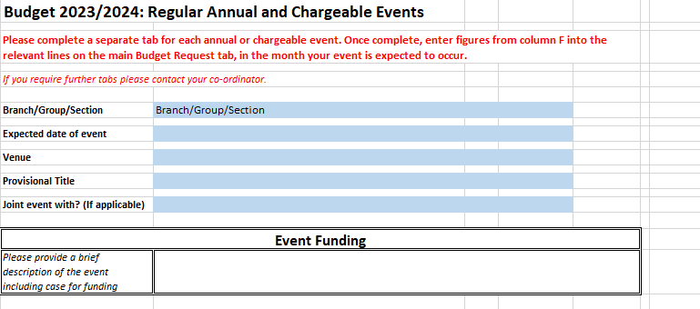
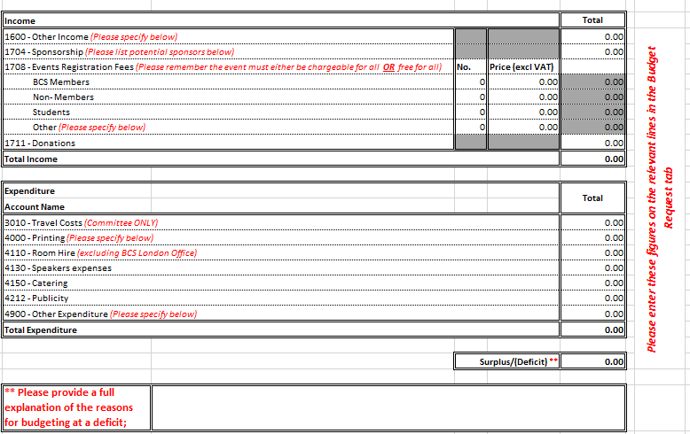
Tab 3 – Chargeable Events Breakdown
This tab only need to be completed if your Branch/Group holds chargeable events. You need to complete separate tabs for each event. Once completed, line totals in column F need to be added into the Budget Request tab.
Enter details regarding the date, venue and provisional title for your event.
Enter a brief description of the event.
Enter the income you expect to receive for your event.
Please remember that the event must be either chargeable for all OR free for all
Enter the expenditure you expect to incur for your event
If your event is budgeted to make a deficit, please provide a full explanation of the reasons for doing so.
Please provide further information if you have used any of these nominal codes

