Slide 1
BCS Slide deck
Template 2023

Slide 2
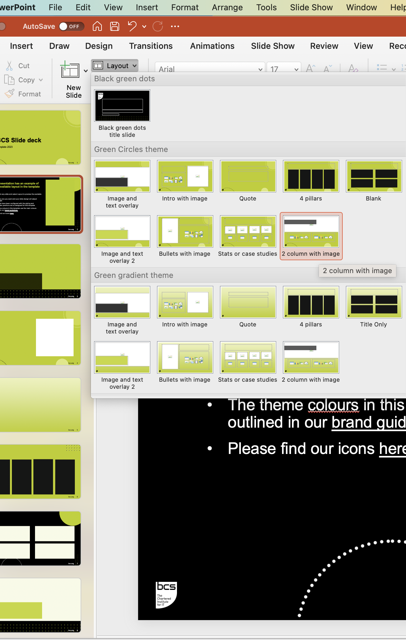
This presentation has an example of every available layout in the template
Right-click any slide and select Layout to preview the available layouts.
Select the one you want and your slide design will adjust accordingly
All layouts have been configured with the styling and placeholder positions we’ve designed for this template
The theme colours in this template use the main colours outlined in our brand guidelines
Please find our brand icons here

Slide 3
Vcbcvbv dsfsd

Slide 11
This is a three column grid
This is a three column grid
This is a three column grid
This is a three column grid
This is a three column grid
This is a three column grid
This is a three column grid
This is a three column grid
This is a three column grid
This is a three column grid
This is a three column grid
This is a three column grid
This is a three column grid
This is a three column grid
This is a three column grid
This is a three column grid
This is a three column grid
This is a three column grid
This is a three column grid
This is a three column grid
This is a three column grid
This is a three column grid
This is a three column grid
This is a three column grid

Slide 12
bcs.org
12

