Slide 1


BCS ITLF Symposium: Suggested Topic Priority for 2026
Symposium
13th November 2025
Chair: Kevin Eagles

Slide 2
BCS ITLF Symposium:
FORMAT:
Five Main Proposals for 2026 ITLF Focus:
  Leadership in Strategic AI Delivery - Dave Sutton (KE stand-in)
  Critical thinking in Business - better decisions, faster - Craig Cockburn
  Architecting Resilience - Paul Reason
  BCS Cyber Security Collaboration with IET CEng (Cyber) - Internet Avalanche (IA) failure - Dr Walter Green
  Cognitive Blind Spots in Security Frameworks:
  From Cybersecurity to AI Governance - Vsevolod (Sam) Shabad
KE Wildcard Slide ☺
Open Floor Discussion
Symposium
13th November 2025

Slide 3
BCS ITLF Symposium: Suggested Topic Priority for 2026
Symposium
13th November 2025
Leadership in Strategic AI Delivery
Dave Sutton (Kevin Eagles standing in)

Slide 4
AI as a Strategic Enabler of Business Systems
Embedding Intelligence Across Business and IT Processes
AI now enables intelligence within:
  Business operations and IT platforms
  Design and development workflows
  Decision-making and service delivery
Benefits include:
  Integration across business processes and functional areas
  Acceleration of development and implementation timescales
  Shift of AI design and build from expert groups to empowered business users
  Technical design is becoming automated enabling in-house development
  Businesses can focus on Business Opportunities
Strategic AI unlocks adaptive, insight-driven organisations
Symposium
13th November 2025
Notes:
Slide 1: AI as a Strategic Enabler of Business Systems
Presenter Notes:
--------------------- AI now enables intelligence within
AI is evolving rapidly, with tools now embedded across business operations, IT infrastructure, and systems design workflows.
As AI matures, the boundary between decision-making and transactional services begins to blur.
Natural language interfaces are starting to replace traditional design and deployment activities—especially in BI, intelligent agent design, and IT workflows.
----------------------- Benefits include
AI acts across business processes and functional areas, enabling dynamic data integration for both decision support and intelligent transactions.
-------------------------- Strategic AI …….
Strategic AI considers the full business context—goals, processes, and systems.
It’s not just a tool, but a capability that shapes business strategy and system design holistically.

Slide 5
Reimagining Business Models Through Strategic AI
From Tactical Tools to Transformational Capability
Strategic AI allows us to:
  Rethink business models and service delivery frameworks
  Embed intelligence into the fabric of organisations
  Align operations with long-term national and sector goals
Common sectors (Utilities, NHS, Local Government) share:
  Business objectives
  Data and systems needs
  Opportunities for collaboration, sharing and reuse
Shared AI ecosystems reduce duplication and cost, while increasing resilience
Shared business and technical solutions, knowledge and best practice can dramatically improve national infrastructure, and reduce costs and delivery timescales.
Bespoke technical solutions inhibiting collaboration can be overcome.
Symposium
13th November 2025
Notes:
Slide 2
Reimagining Business Models Through Strategic AI
Presenter Notes:
---------------------------------------- Strategic AI allows us to
Business models define how an organisation operates, what functions are considered core, and how services are delivered.
IT and AI can be positioned as core capabilities—or treated as peripheral. Strategic AI invites us to rethink this positioning.
Service delivery models must evolve to reflect how organisations partner, outsource, or insource capabilities.
Long-term national goals—such as the UK leading in AI services—require collaboration across sectors like utilities and NHS Trusts.
--------------------------------------------- Bespoke technical ………
Historically, collaboration has been blocked by parochial management and bespoke IT solutions. AI enables shared knowledge bases and reusable components, unlocking cross-sector innovation.

Slide 6
Building National Capability for AI Deployment
Strategic AI Delivery as a Sovereign Asset
AI must be treated as a national capability, not a tactical add-on
Requires investment in:
  Business Systems Design
  Programme and Service Management
  Enterprise Architecture
  Semantic and interoperable data models
UK must retain control over:
  AI strategy and delivery
  Technical leadership and assurance
  Ethical and inclusive adoption across sectors
BCS can convene and guide this transformation
Symposium
13th November 2025
Notes:
Slide 3: Building National Capability for AI Deployment
Presenter Notes:
--------------------- AI must be …….
To lead in AI services, the UK must treat AI as a national capability—not something outsourced to third parties.
AI enables organisations to become more agile, innovative, and responsive to future challenges.
-------------------------- Requires investment in ……..
Our methodologies must evolve to incorporate AI at every level—allowing business analysts and architects to model intelligent processes.
These methodologies must reflect not only current best practice but anticipate rapid change and future capabilities.
The challenge is to reimagine business models and processes that are designed from the outset to harness AI’s full potential.

Slide 7
The Risk of Inaction and the Role of BCS
Safeguarding the Future Through Strategic Leadership
Risks of fragmented, tactical AI adoption:
  Poor security and resilience
  Duplication of effort and cost
  Loss of capability through outsourcing
  Tactical rather than strategic futureproof solutions
Strategic AI governance ensures:
  Smarter, futureproof systems
  Sovereign oversight and ethical standards
  Inclusive opportunity and global leadership
BCS can lead the way:
  Convening cross-sector expertise
  Supporting capability development
  Embedding AI into the UK’s digital infrastructure
Symposium
13th November 2025
Notes:
Slide 4: The Risk of Inaction and the Role of BCS
Presenter Notes:
----------------- Strategic AI governance ensures:
Strategic AI must be recognised as a core capability—not an outsourced function.
UK leadership must treat AI deployment as a national asset, capable of transforming sectors like utilities, healthcare, and local government.
With the right governance and collaboration, the UK can become a trusted global leader in Strategic AI.
This capability must be measurable—organisations should be assessed on their ability to grow and retain AI and IT leadership.
-------------------- BCS can lead the way
The BCS has a pivotal role to play: convening expertise, guiding best practice, and safeguarding the UK’s future in AI-enabled business systems.

Slide 8
Thank you
Symposium
13th November 2025
Dave Sutton
davesutton19@gmail.com

Slide 9
BCS ITLF Symposium: Suggested Topic Priority for 2026
Symposium
13th November 2025
Critical thinking in Business
better decisions, faster
Craig Cockburn

Slide 10
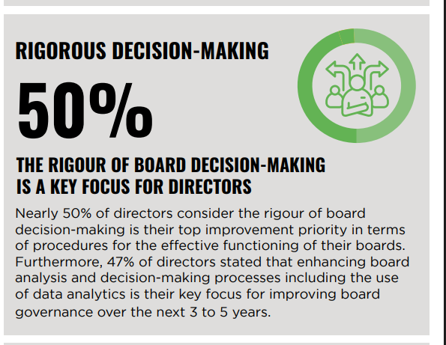
Decision making in business
Symposium
13th November 2025

Slide 11
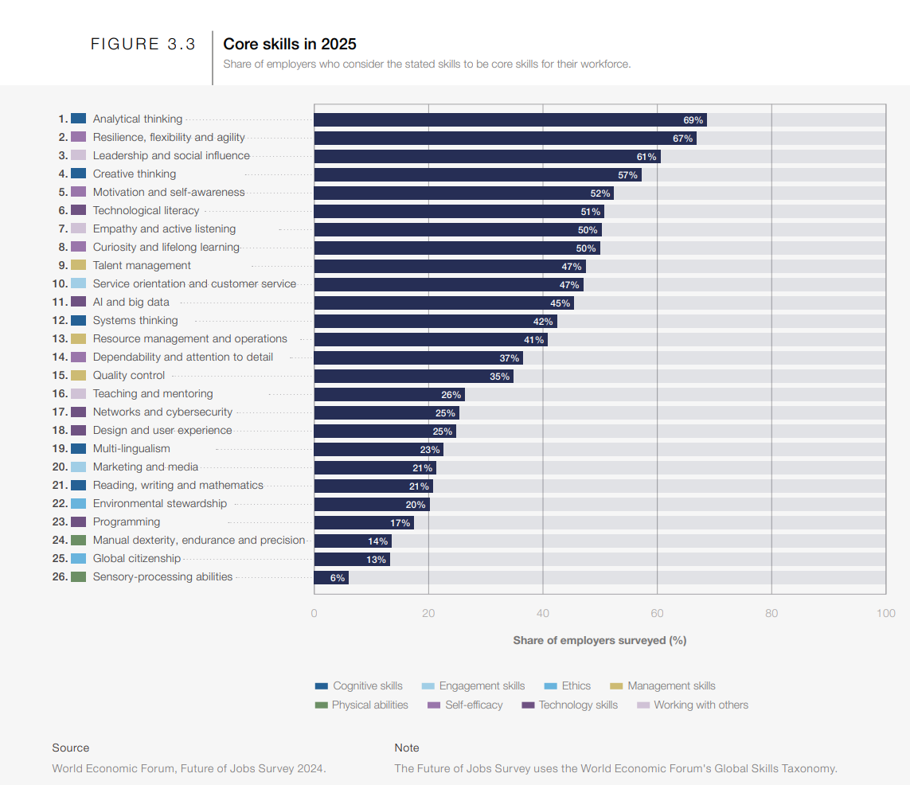
Decision making in business
Symposium
13th November 2025

Slide 12
Decision making in business
What is critical thinking, history and applications
How it has been adapted to business
How it works
Why it matters
Feedback and praise from business leaders
A few practices
My experience in this field
How can you get started?
Symposium
13th November 2025

Slide 13
Thank you
Symposium
13th November 2025
Craig Cockburn
www.craigcockburn.com
craig@siliconglen.com

Slide 14
BCS ITLF Symposium: Suggested Topic Priority for 2026
Symposium
13th November 2025
Architecting Resilience
Paul Reason

Slide 15
Background
  Recent news about Major Companies being ‘hacked’ in a way that that they cannot recover their operation for weeks and months to fully complete the recovery.
  The cost to the organisation is significant and is impacting the GDP of the country.
  Assumptions about the company:
Systems are highly integrated including suppliers and other 3rd parties
Integration is place, tooling that provide data, application and business mechanisms
Security in place [but obviously incomplete]
Have Disaster Recovery (DR) in place and is tested
Have immutable backups in place
DR Insurance is in place
We are looking to discuss what could be improved upon with major changes to the systems
Symposium
13th November 2025
Notes:
We have seen a number of events in the news about cyber attacks on major Uk companies in a significantly disruptive way
Here we look at the type of company, the attack and some ideas as to how simple architecture changes can improve both resumption and resilience. This is not an exhaustive list but a starting point.
Most of the details are gleaned from the news, but the impact is significant:
M&S profits down almost £400M including an insurance payout of £100M
JLR production was out for over 6 weeks at £50M/ week
I believe in most cases the length of time that the service was down is because these are highly integrated systems at it is difficult to realign the IT systems with the operational state.
And that they have working DR procedures - or they would still be down.
The key factor is that these are highly integrated systems that interface with both suppliers and customers. The integration creates efficiency but is opening up the organisation to attack.

Slide 16
Event
  A major attack rendering systems inoperable, aimed to encrypt underlying data with a ransom to enable keys to decrypt the data.
Impact:
Loss of Business and major supply chain disruption
Business and IT out-of-sync
  IT systems do not reflect the current operational state.
Options:
1. Pay ransom
  Issues (1) Dealing with Criminals
(2) Recovery may be out of sync anyway
2. Implement Recovery
including resync of the IT systems to operation
Issues:
Complexity of recovery
IT systems and the Operation are out of sync
What expense will this incur, lost or spoilt stock, incomplete production
Symposium
13th November 2025
Remedial Actions
The following will need to be accomplished:
Isolate the systems from the internet
Remove the attack vector
Recover all systems and data (by whichever option)
Realign the IT systems to the Operation
  This is the complicated part and may require emptying the production line for restart
  Loss of parts and build quality could be significant
Restart the systems
Reconnect to internet
Notes:
A major attack rendering systems inoperable, this was about encrypting the underlying data and a ransom made for the decryption keys. This was very public in the case of M&S.
In some cases this was internally thwarted by disconnection of services before attack was complete (CooP). However, this still created the problems of the systems being out of sync with the operation.
So what our Coop options:
PAY RANSOM
This would involve:
Isolate from Internet
Remove attack vector
Decrypt data
Realign systems
Restart
However,
we will still have systems out of sync,
Should we be dealing with criminals?
BUT THIS MAY HAVE A BUSINESS CASE
Start Recovery
As per the remedial actions
Isolate External Access
Remediate the attack vector and any residual attack components (this may require a complete rebuild from bare metal
When we rebuild the systems this will need to come from immutable backups or checkpoints but this will not be aligned to the operational state.
Realin IT systems to the operation THIS IS NOT SIMPLE and I don't believe is a tested process
Restart, Test
Reconnect
In the case of JLR this involved removing all of the partially completed products from the production line!

Slide 17
What could we do instead?
A key issues here is if we are spending large amounts on our cyber security why are we looking at other approaches, until we have this sort of event!
Insurance will be limited.
We need to adopt cost effective approaches based on existing technology, such as:
System Segregation, providing isolation for key systems
  Keeping the key production systems further away from attackers with controlled interfaces.
  Having complete data (complete copies)so the system can run for short periods in isolation and allowing production process to complete
  This may need changes to some changes to the Just-In-Time stock operations.
Transactional logging, that can be read and replayed to recover our system
  An immutable log of the transactions, would enable replay to get the systems up to the state of the operation.
  Integration could be expanded so that transactions are written to a external service, which can be read.
Symposium
13th November 2025
Notes:
This is the area that (I think) is interesting.
Key problem we are already spending on cyber security so
How do we justify this additional spend. It must be more than another insurance policy.
We need to expand what we have in place to give us improved tools for recovery, ideally provide additional benefits but Insurance will not cover the losses it is reported that M&S got £100M from Insurances and their profits were down by £390M after the payout.
Here are two examples of simple Architectural changes that would both improve recovery procedures and improve resilience, there are many other including digital twins which could be included
System Segregation
As performed in the defence world changing the setup of our key operational systems so that they are segregated with limited (controlled) interfaces so they are a further level away from the attack will provide protection.
There will be requirements to change the operation so that these systems know that everything they require is available before starting.
If we assume that we do not starting building until we have a schedule of the components available. Then the build / production system will be able to run (this component) to completion. Atleast allowing for clean production lines!
Transactional Logging
If we log all events into an immutable data store (I think blockchain) we have the ability to recover to the same point as the operational state.
This would still require the recover process to be completed to the last backup.
If we assume that an Integration Layer is in place then we can use this to write the transactions (log) to our storage platform.
By creating new processes in our Integration layer that enable us to read back the transactions we can re-apply them.
This is not trivial but is achievable and the tooling could provide benefits such as monitoring and investigating exceptions.

Slide 18
Next Steps
Discussion & Questions
What other components can be managed in the same way?
Is it worth developing this as a white paper?
Can you help?
Symposium
13th November 2025

Slide 19
Thank you
Symposium
13th November 2025
Paul Reason
Paul@Reason.me,uk

Slide 20
BCS ITLF Symposium: Suggested Topic Priority for 2026
Symposium
13th November 2025
BCS Cyber Security Collaboration
with IET CEng (Cyber)
Dr Walter Green
PhD, MScEng, CEng, CITP, FBCS,FIET FAIM, SMIEEE, FIEAust
Notes:
Thank you Jonathan

Slide 21
Introduction
In my opinion the UK has made a significant impact on the security of IoT devices.
There are opportunities to significantly improve the security of IoT and IIoT devices.
Several of the standards and OS used today have lacked an integrated approach.
The BCS and the IET have the combined competencies to deliver more systems with significant improvements in security and flexibility.
Symposium
13th November 2025

Slide 22
Introduction (cont…)
Need for Collaboration
BCS members have the competencies in operating systems and coding practices,
IET engineers have the mathematics and telecom competencies in assessing the level of security of systems and telecom network issues.
ALL of these Competencies are needed for Autonomous Systems
The discovery in 2024 of a new Cyber Threat will be used to demonstrate the need for Collaboration
Symposium
13th November 2025

Slide 23
Autonomous Systems Weaknesses
Operating Systems
Deficient OS with little or no security
No internet Stack security
No protection of Code
No Safe Storage of Forensic Investigation Data
Level of Security
Weak (Less than 256 Bits) or No Passwords Password management weak or non existent
Network
Internet and protocols are inherently unstable
Weak Authentication and Validation
Symposium
13th November 2025

Slide 24
Internet Avalanche Discovery
Internet Instability
  Advanced Maths and Telecom Theory to transform Internet Instability criteria into measurable parameters
  Application of Telecom traffic theory to understand how an Internet Avalanche is activated
Internet Risk Management
  Interaction of End-User behaviour and common network designs that cause Internet avalanches to occur
  Why Internet Avalanche failures occur and restore without human interaction and with no trace of what happened
Symposium
13th November 2025

Slide 25
Internet Avalanche Summary
Three types of Internet Avalanche (IA) failure
  Intermittent Poor services to internet, servers and printers
  Simultaneous Loss of Telephone, Email and Internet
  Increasing Outgoing bandwidth
Keep Ratio of Incoming traffic to Outgoing Link capacity to less than 10, preferably less than 6
The amount of traffic to start an IA is much higher than the traffic to maintain and IA
An undesirable feature of an IA network failure is the reduction in Outgoing Link capacity
Symposium
13th November 2025

Slide 26
Summary
The BCS and IET implement a process to enable BCS members and IET members to collaborate when creating new solutions and/or responding to new threats.
Possible projects are;
  Collaboration on developing more secure IoT and IIoT systems
  Collaboration on creating Groups of Standards to achieve different outcomes or tasks
  Collaboration on responding to new Threats
Symposium
13th November 2025

Slide 27
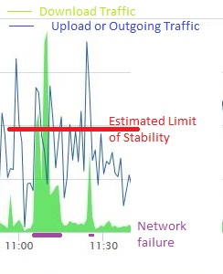
Internet Avalanche Event
Symposium
13th November 2025

Slide 28
Thank you
Symposium
13th November 2025
Dr Walter Green

Slide 29

BCS ITLF Symposium: Suggested Topic Priority for 2026
Symposium
13th November 2025
Cognitive Blind Spots in Security Frameworks:
From Cybersecurity to AI Governance
Vsevolod (Sam) Shabad, FBCS
Based on SSRN Working Paper 5525340
Full version available at https://dx.doi.org/10.2139/ssrn.5525340

Slide 30








My background
Born in USSR, UK resident since 2024
Eight countries, six industries
Studied in Russia, Switzerland, USA, UK
Four decades in IT and Cybersecurity
Former CISO & CIO of leading banks in Kazakhstan
Principal Enterprise Architect @ BT Group
Researcher @ University of Liverpool
This experience revealed cross-sector patterns — the basis for today’s analysis
Symposium
13th November 2025

Slide 31
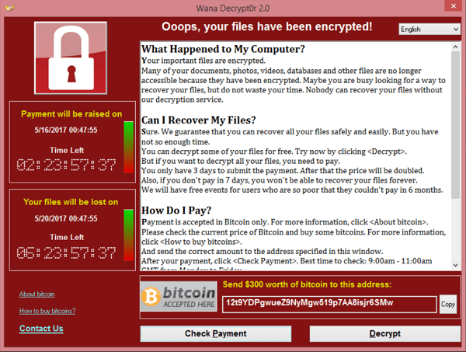

Why governance frameworks fail — even with ”best practice”
Anchoring bias: old assumptions treated as truth
  NHS trusts anchored on 2014 plan → WannaCry £92m
Overconfidence bias: compliance mistaken for resilience
  “We followed the standards” — SolarWinds systemic compromise
Temporal mismatch: governance moves yearly, adversaries weekly
  ≈ 46:1 prevention/recovery cost ratio (Ponemon, NAO)
Symposium
13th November 2025
Anchoring
Overconfidence
Temporal mismatch

Slide 32
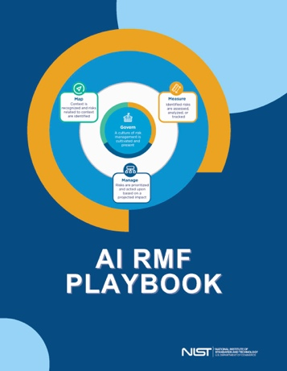
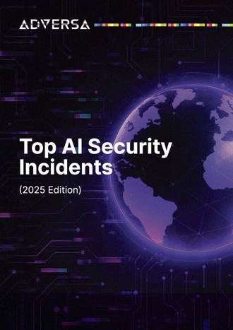
AI governance repeats cybersecurity’s mistakes
Framework cloning: ISO 42001, NIST AI RMF mirror cyber logic
  Anchored risk scopes → outdated assumption persists
Exponential drift: AI evolves faster than governance cycles
  AI security incidents doubled from 2024 to 2025 (Adversa AI)
Missing feedback loops: no AI-specific threat intelligence
  No CVE/STIX feeds → biases persist unchecked
Symposium
13th November 2025
Anchoring
Overconfidence
Temporal mismatch

Slide 33
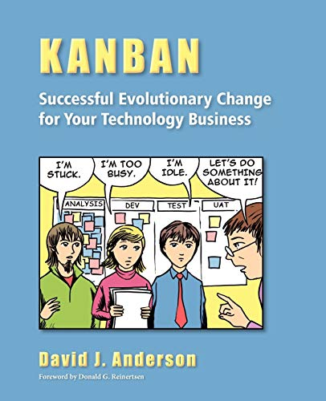
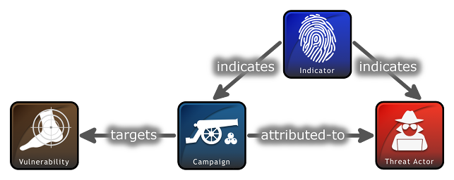

Building bias-resistant governance
Flow limits — shorten governance cycles
  Apply WIP limits and iterative reviews → prevent anchoring on old plans
Shared intelligence — AI threat-intel ecosystem
  Extend STIX/TAXII feeds → create shared “IoC for AI”
Bias checkpoints — structured challenge sessions
  Periodic assumption challenging → counter overconfidence and inertia
Symposium
13th November 2025

Slide 34

Thank you
Open to collaboration on bias-aware governance across cybersecurity and AI.
Full 17-page preprint available on SSRN https://dx.doi.org/10.2139/ssrn.5525340
Symposium
13th November 2025
Vsevolod (Sam) Shabad
vshabad@vshabad.com
linkedin.com/in/vshabad
www.ssrn.com/author=7847528
Quick questions
or comments?

Slide 35
BCS ITLF Symposium:
Wildcard Slide
Mitigating the AI bubble (Southsea Bubble – Dot.Com meltdown)
Agentic AI (e.g., prompt injection, ethical concerns such as bias and accountability, and technical hurdles like data quality, system interoperability)
Legislating ethical use of AI (e.g., European Union's comprehensive AI Act )
Mitigating Aggressive Use of Drones (hostile use at civilian airports
Guidance with Vibe coding (holy moly – where will it all end ☺)
Symposium
13th November 2025

Slide 36

BCS ITLF Symposium:
Open Floor Discussion
Symposium
13th November 2025

