Slide 1

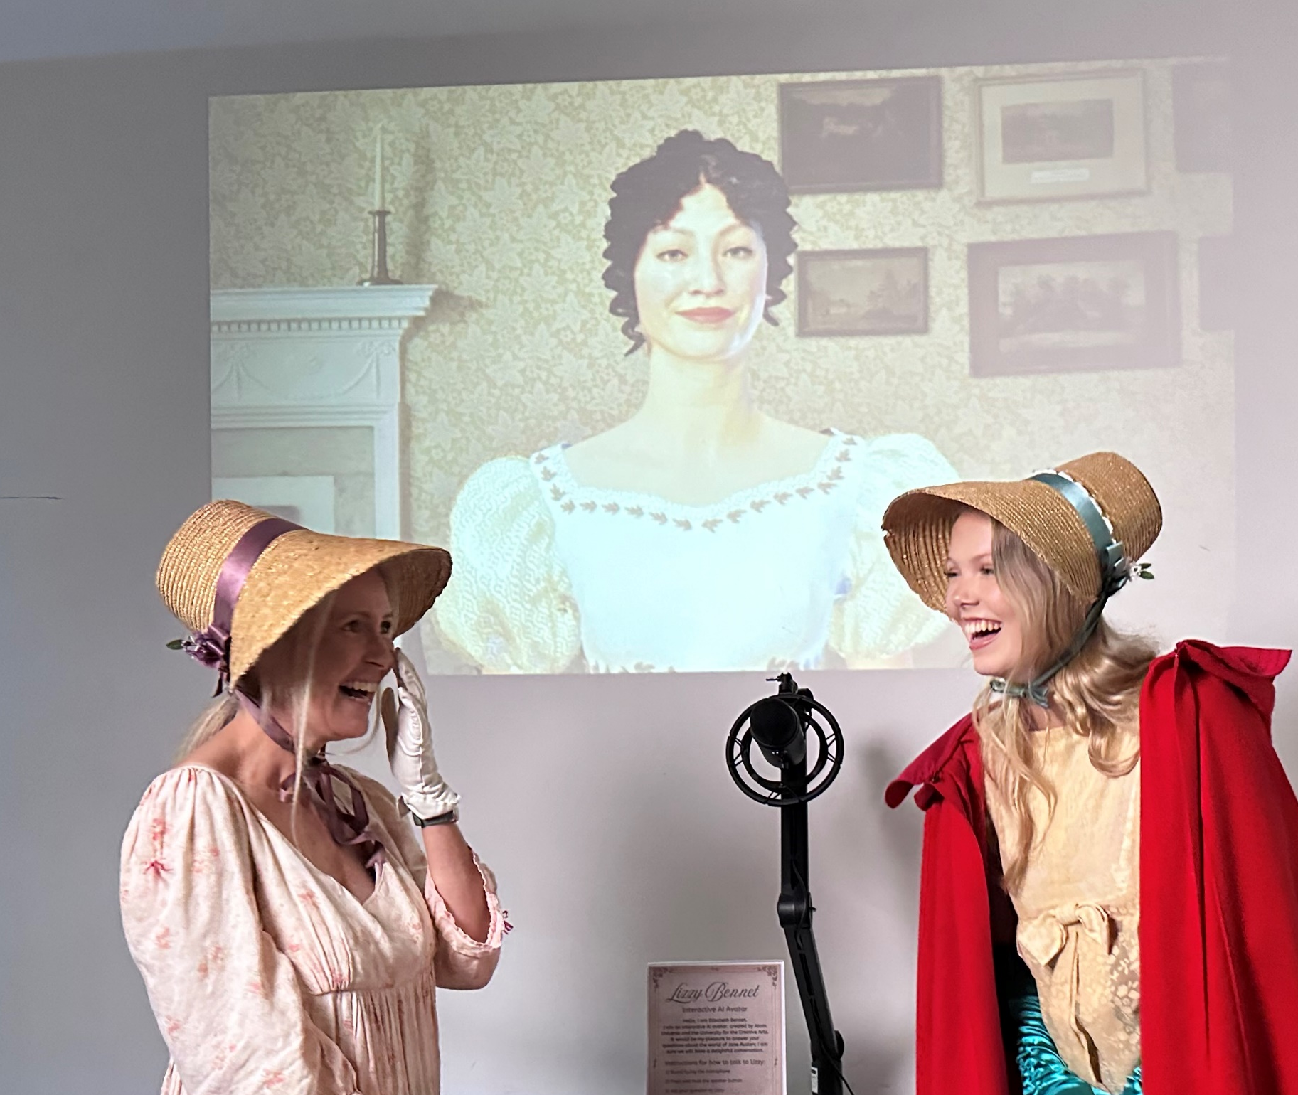

The making of Lizzy Bennet
Making AI avatars accessible and fun
WWW.starpal.ai
Finalist 2024
1

Slide 2
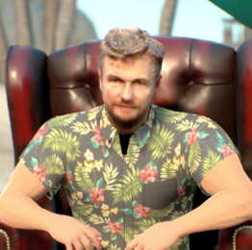
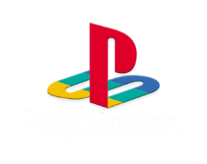


Introducing Tanguy
TANGUY DEWAVRIN
COO
30y in the games industry
Game & art design expert
AAA games leading licences
Virtual world pioneer since 2009
Launched leading metaverse on PlayStation with 2m installs

Slide 3



Introducing Dan
DAN ANTHONY
CTO
16y in AI & games programming
16 years in the game industry
13 published games
Launched his own studio
Tech lead
CS University major

Slide 4
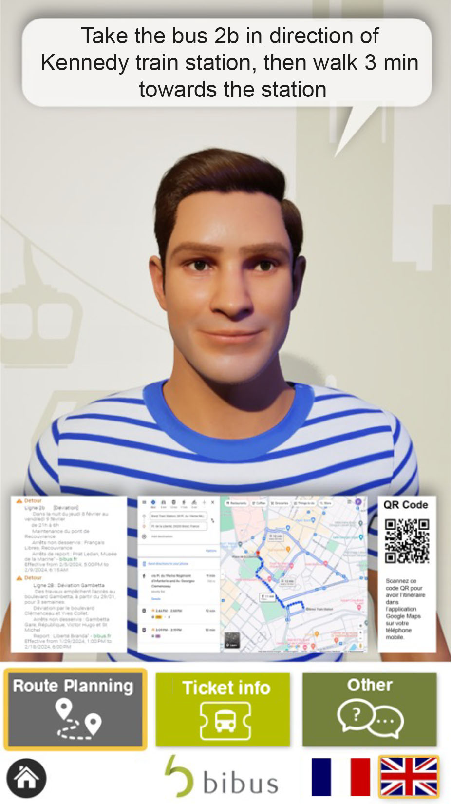
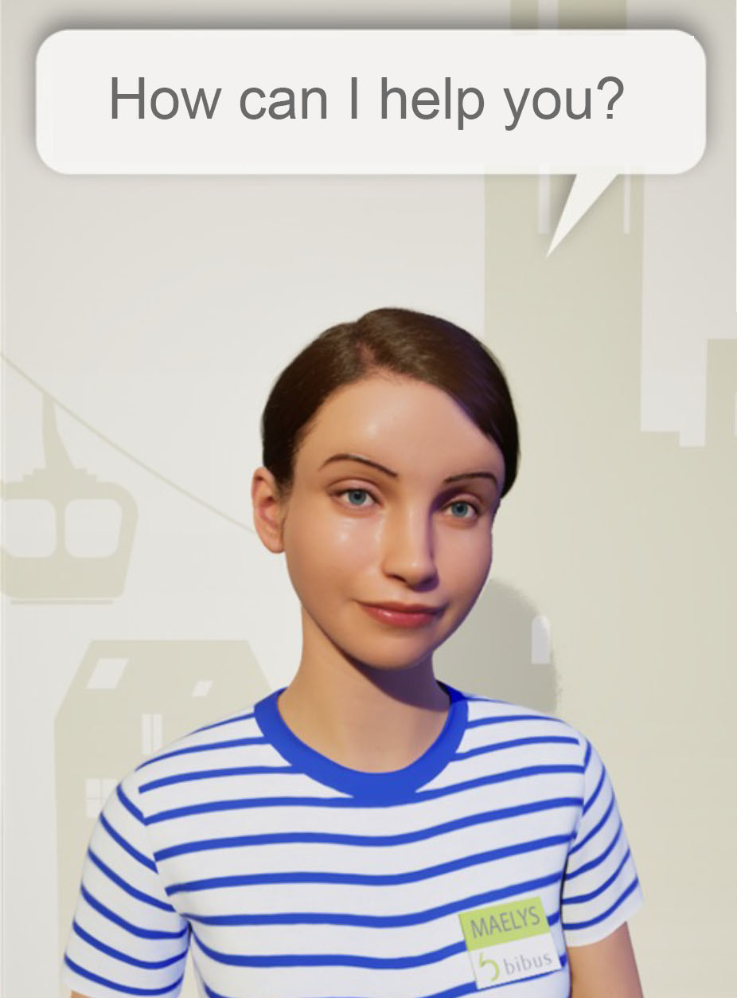
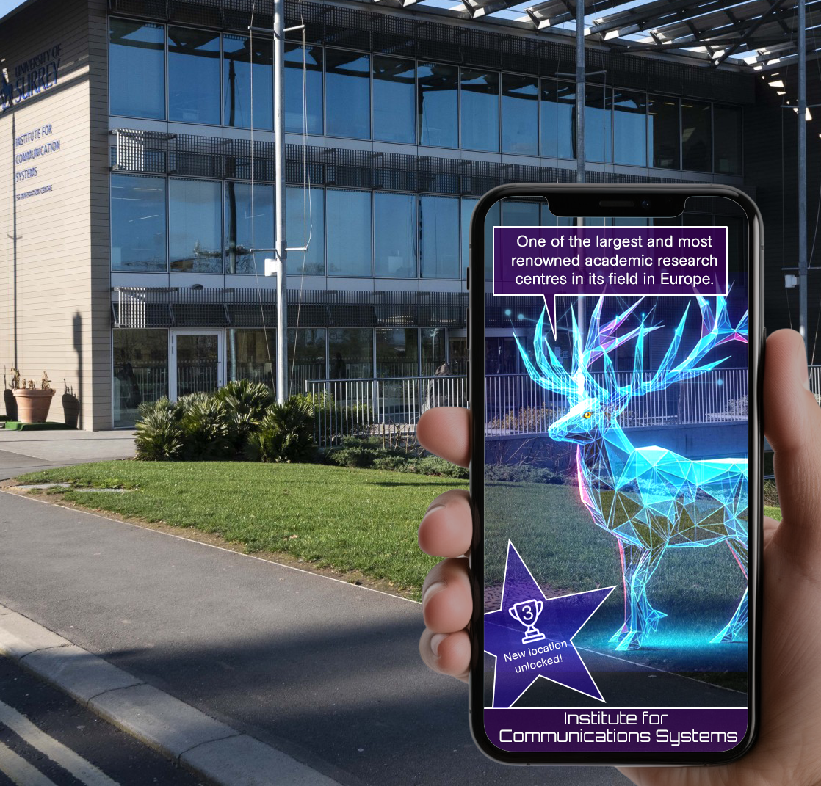

Virtual agents
Pixar-style service agent (client: leading public transports RATP)
AR virtual tour guide

Slide 5
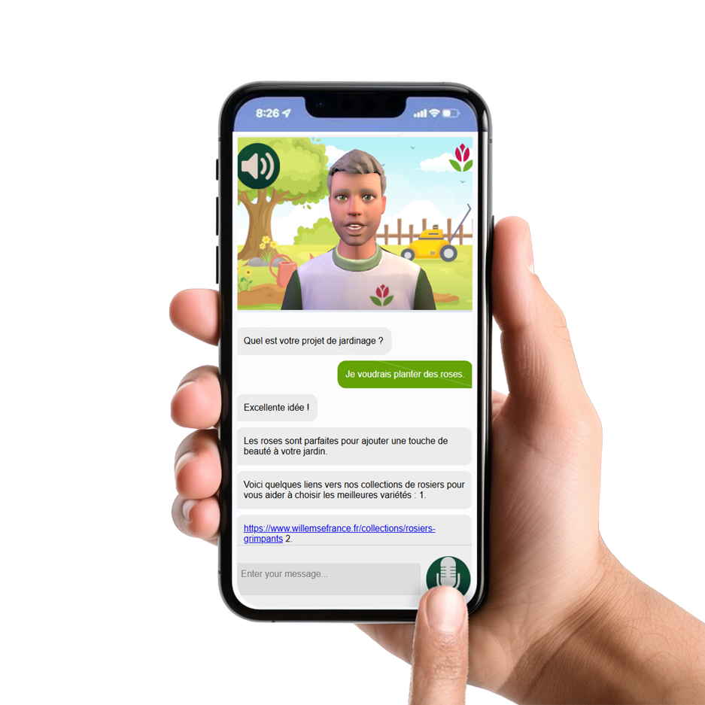
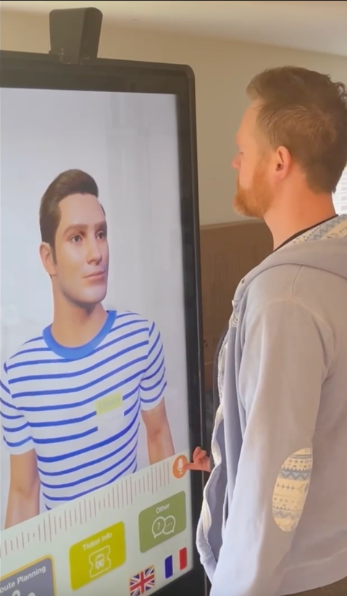
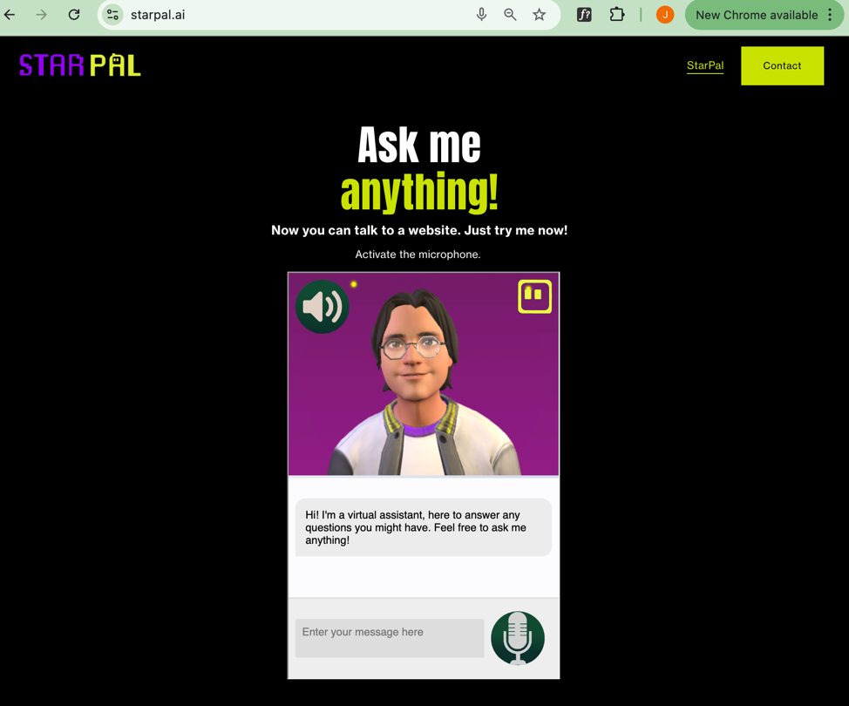
MULTI-CHANNEL agents
In browser
On mobile
In kiosks

Slide 6
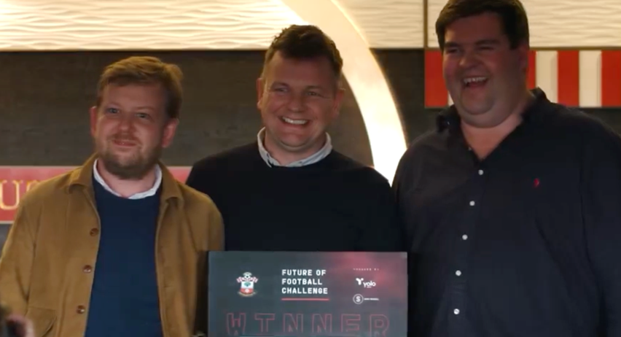
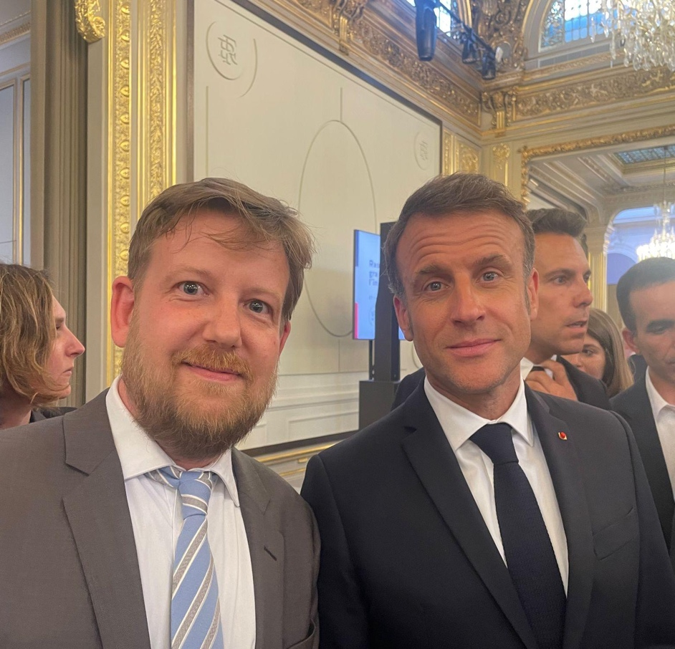

AWARD WINNING COMPANY
“Meeting of the greatest talents in AI”
We won the ”Future of Football” competition from the Premiere League Southampton Football Club, among 260 participants
StarPal was nominated in the top 3 for AI & gaming tech at the UK national AI awards 2024
Selected to meet with the President E. Macron at the “meeting of the greatest talents in AI” ; Presented StarPal to offer an inclusive AI that embodies “Albert”, the public services AI agent being created by the government

Slide 7







Our positioning on the value chain
LLM
UX
AI agent training
Avatar creation tool
API / back-end

Slide 8
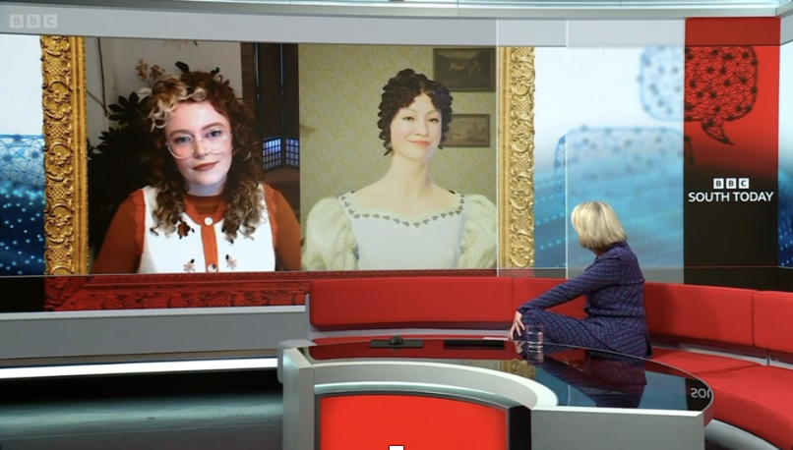

See it live
BBC interview with the avatar of Lizzie Bennet

Slide 9
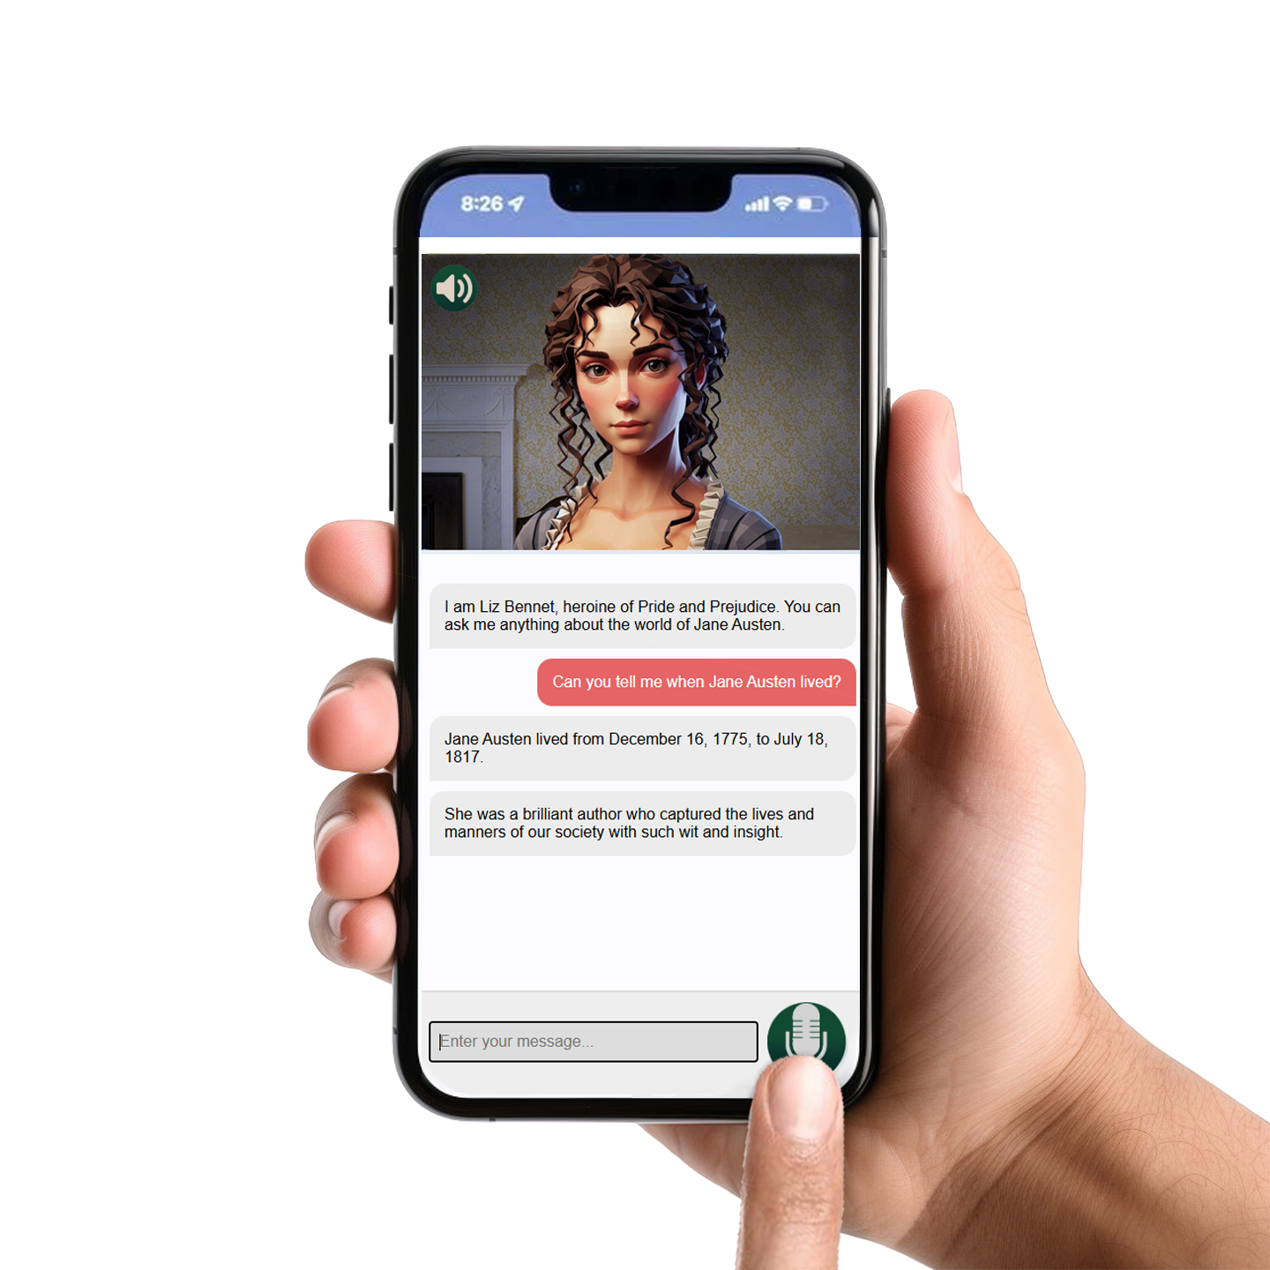
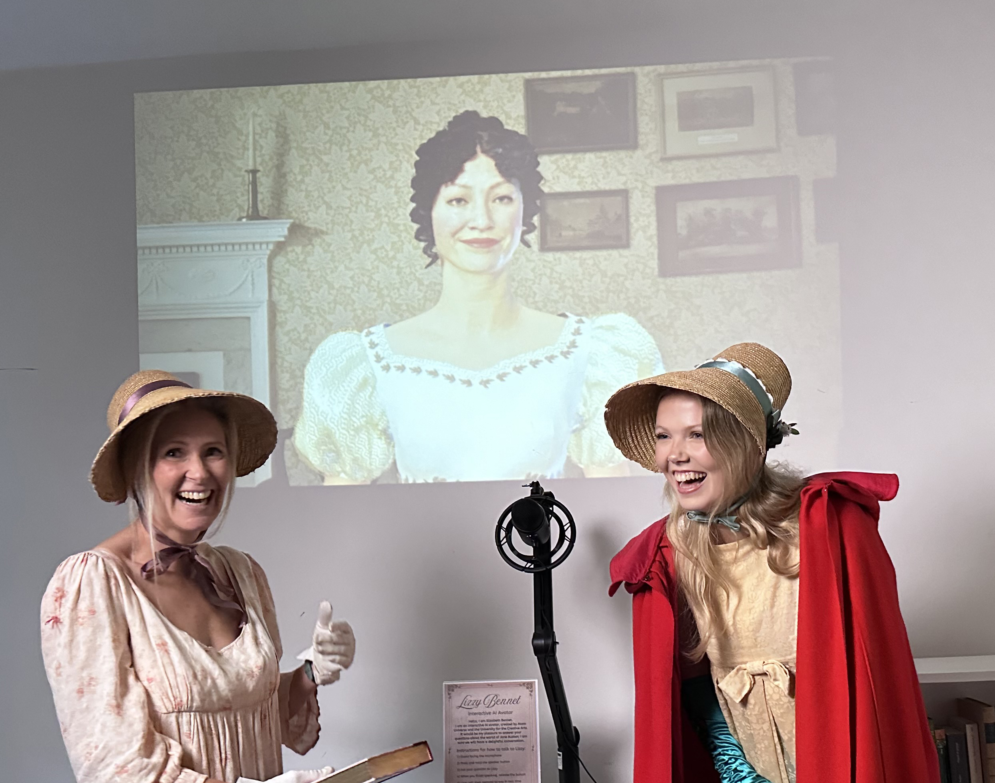
Multiplatform
Speak with an avatar who has all the knowledge of the place and its history for a learning experience that is
-more interactive
-fun
-memorable
Companion app available on mobile to entice more visitors

Slide 10
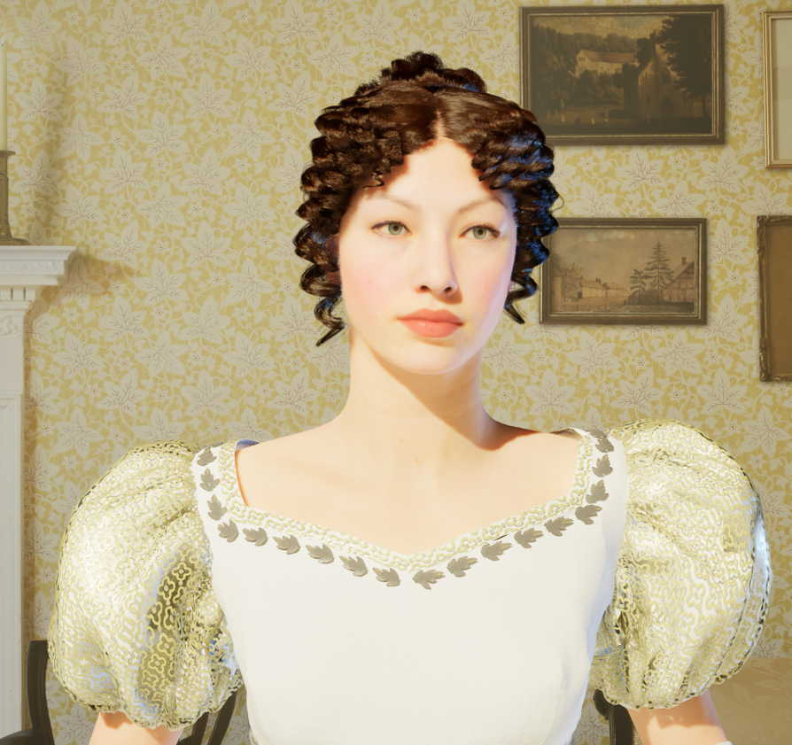

THE Lizzy Bennet AVATAR
Interact with the fictional character
Attract users : on the website and at the museum
The avatar of Lizzy Bennet from the best selling book Pride & Prejudice by Jane Austen. Created from numerous sources of inspiration, in collaboration with UCA
(Speak with Lizzy Bennet in the Jane Austen museum, to attract visitors)

Slide 11
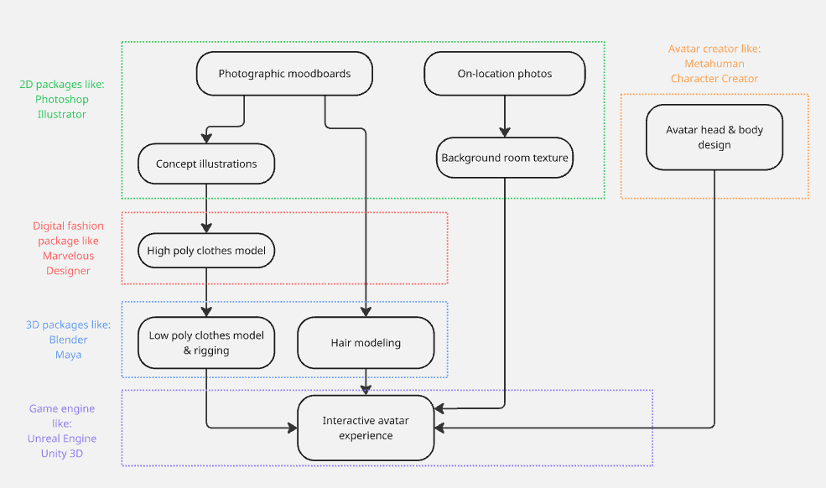
THE ART PIPELINE

Slide 12
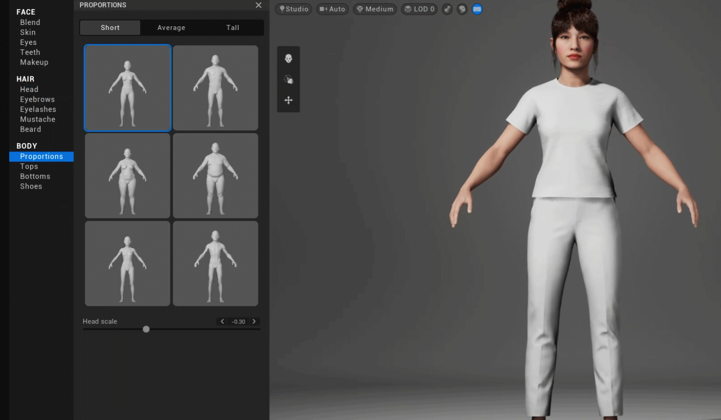
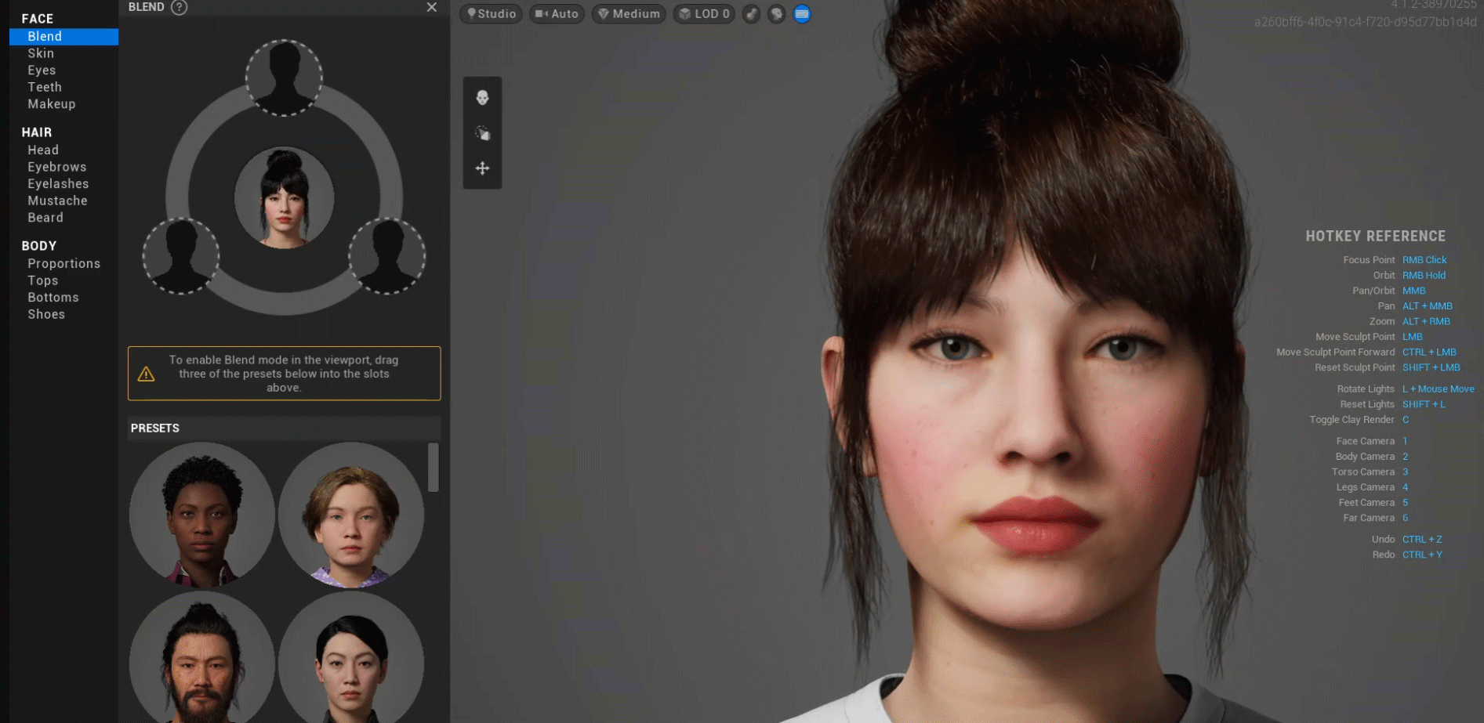
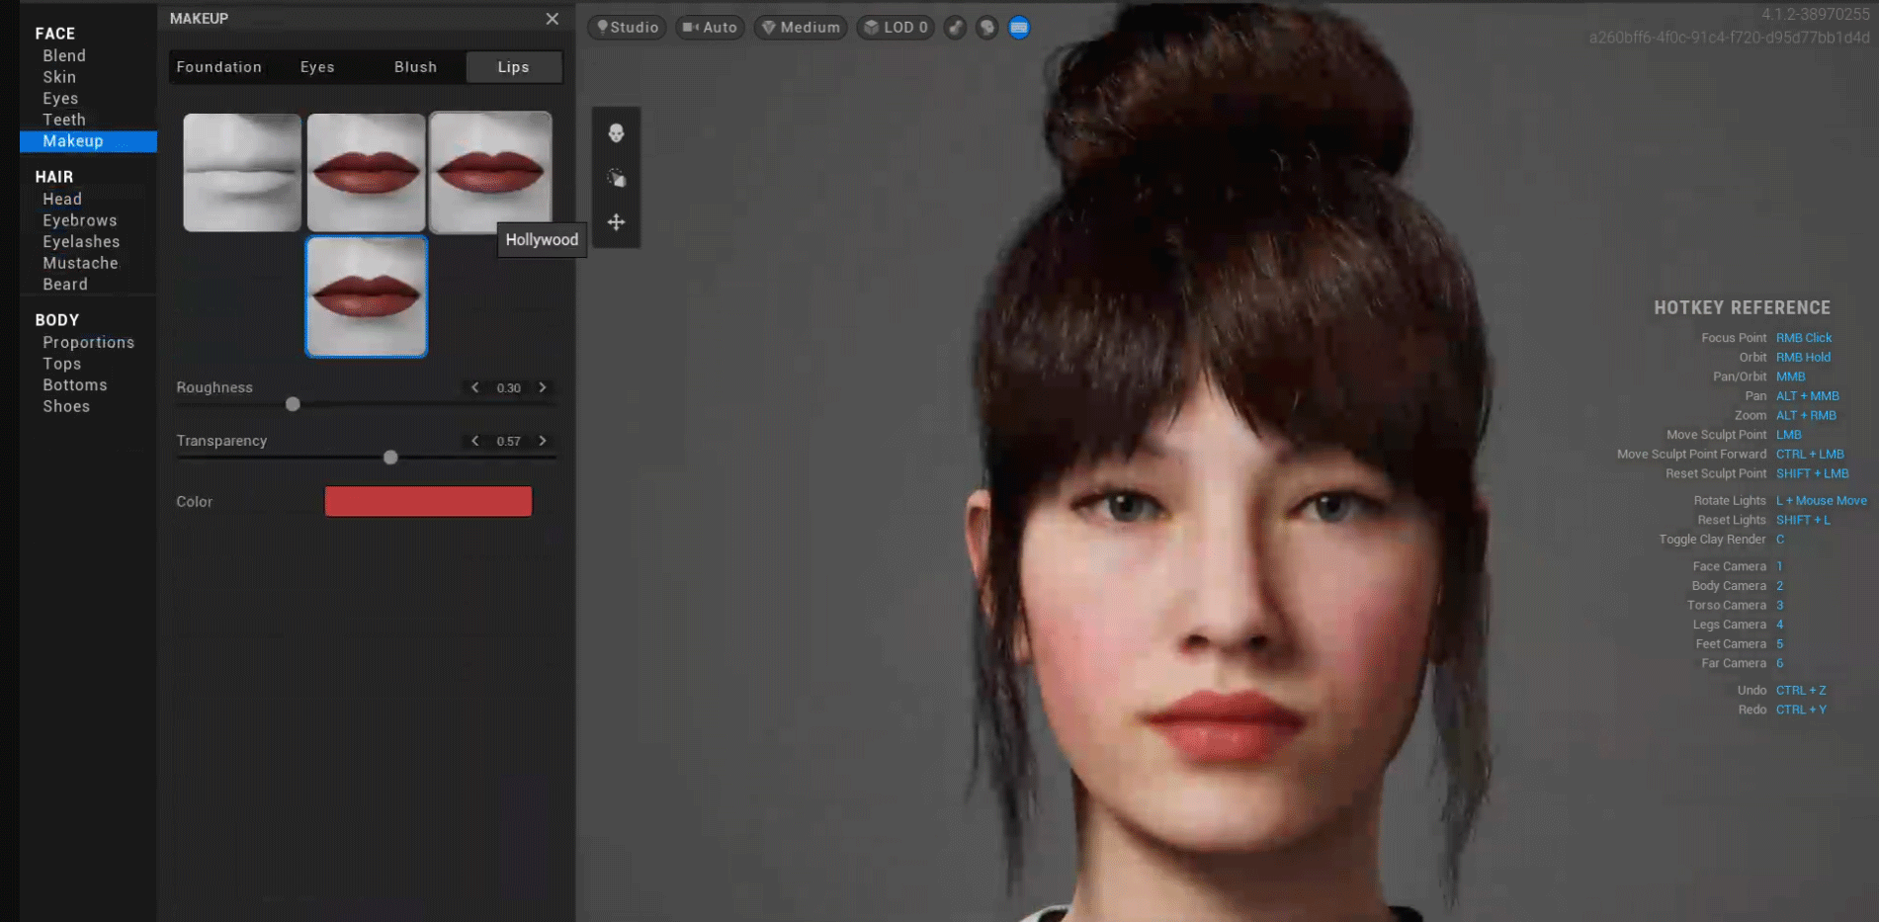
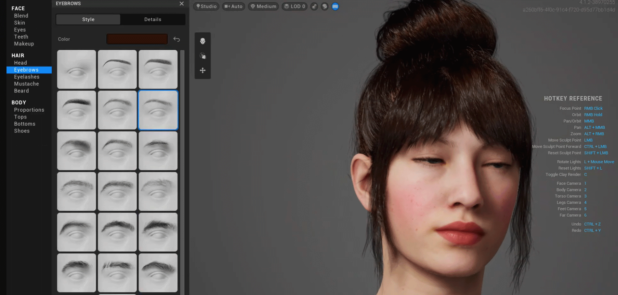
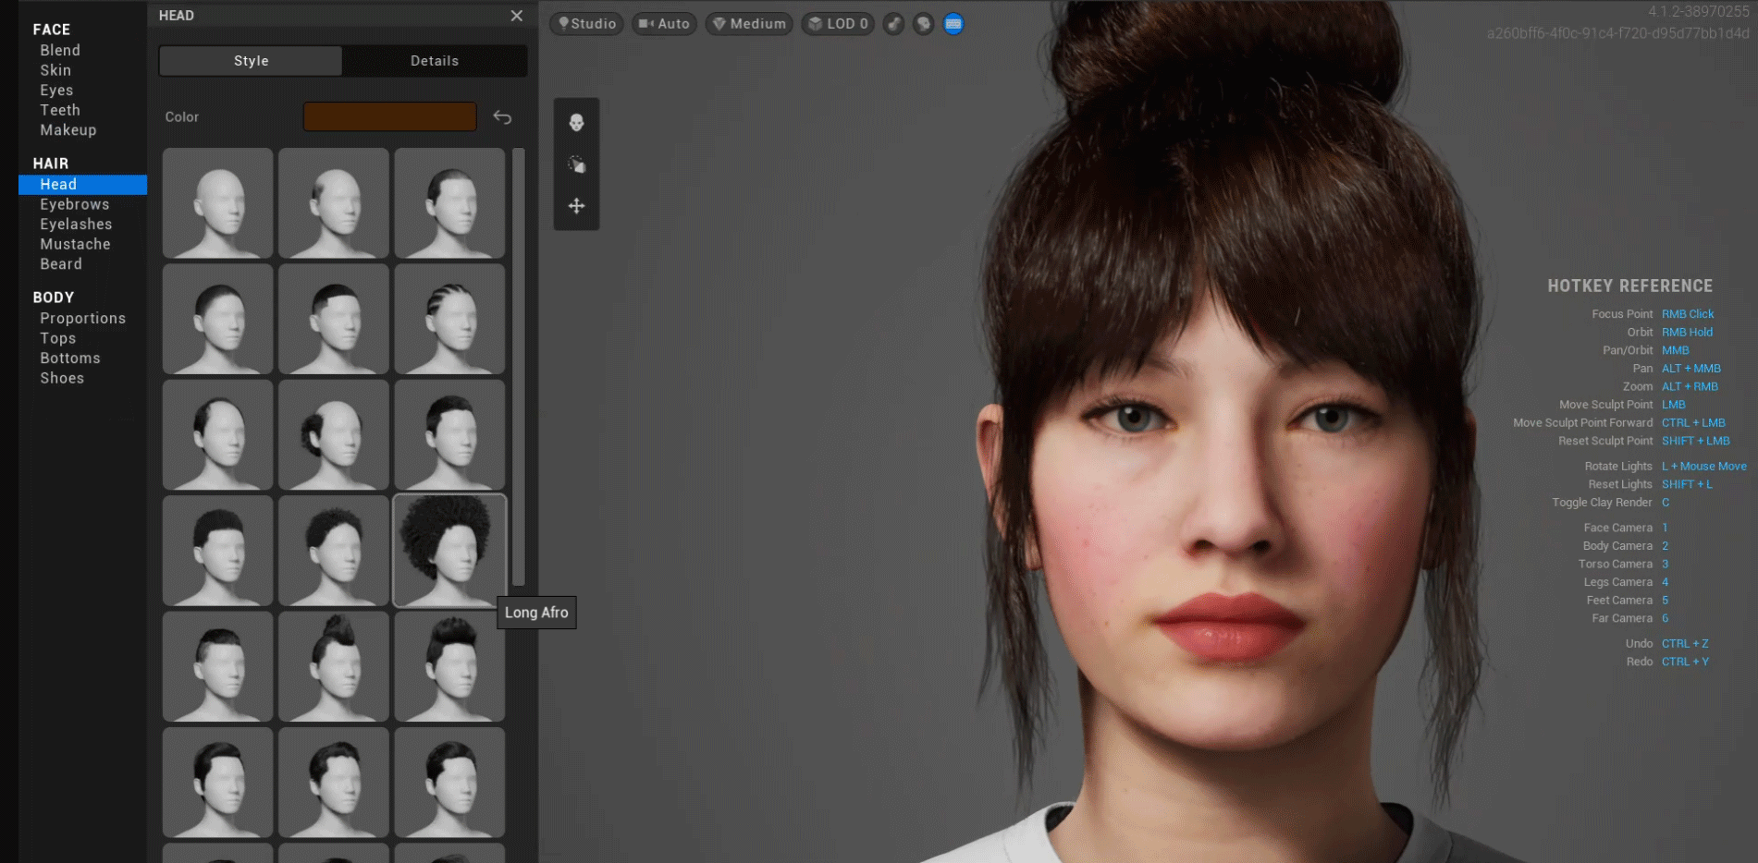
Avatar design

Slide 13
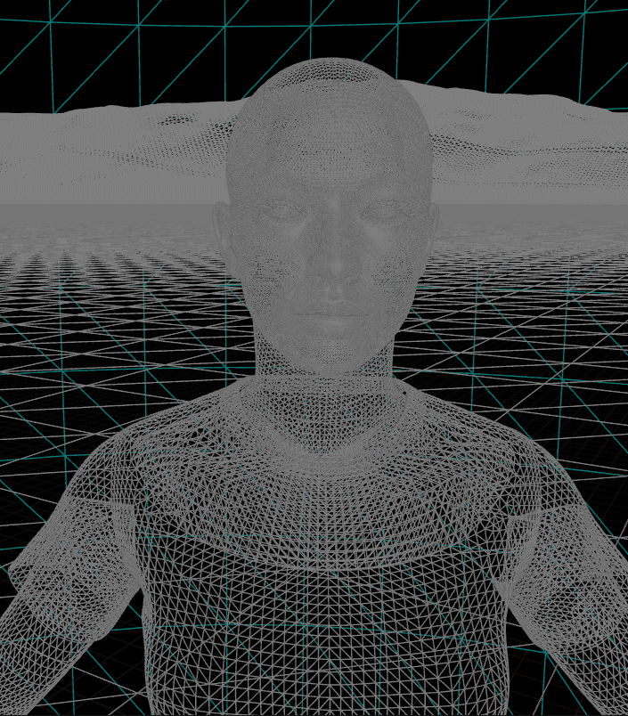
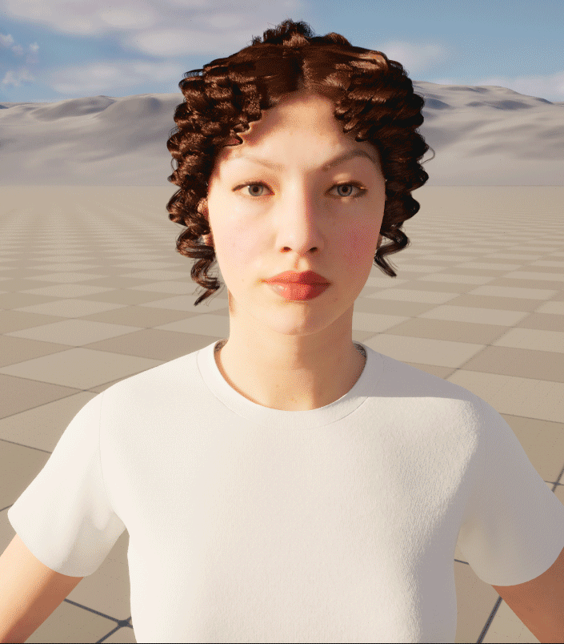
Avatar 3D model in the game engine

Slide 14
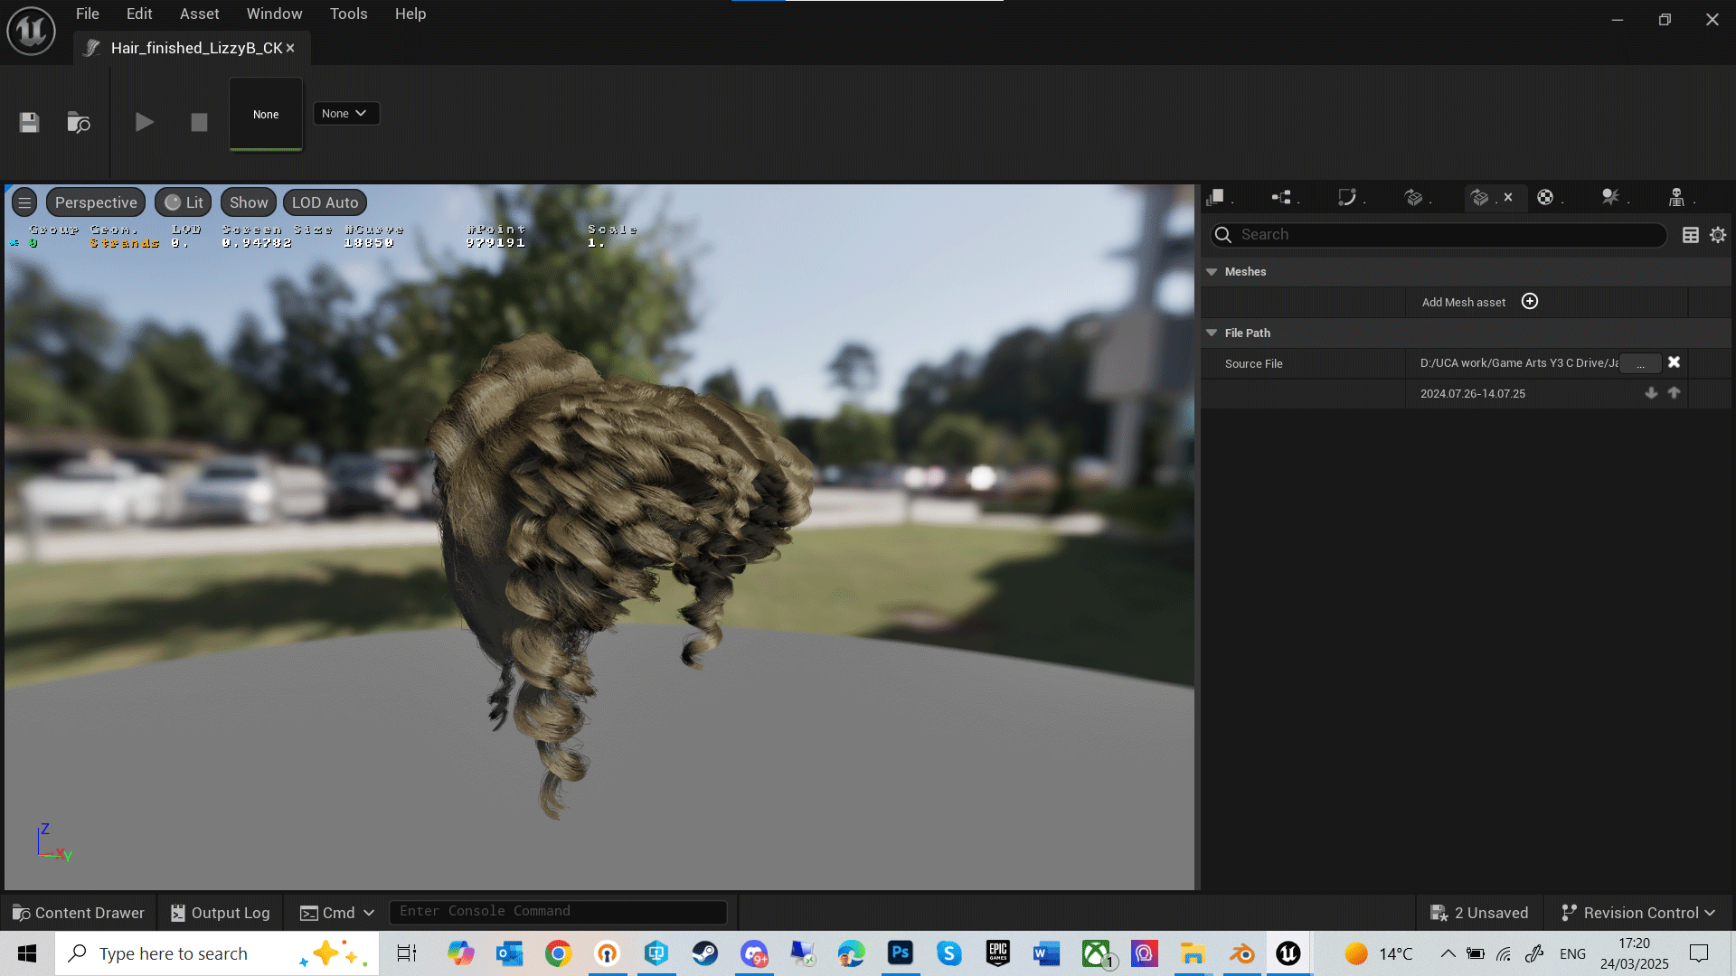
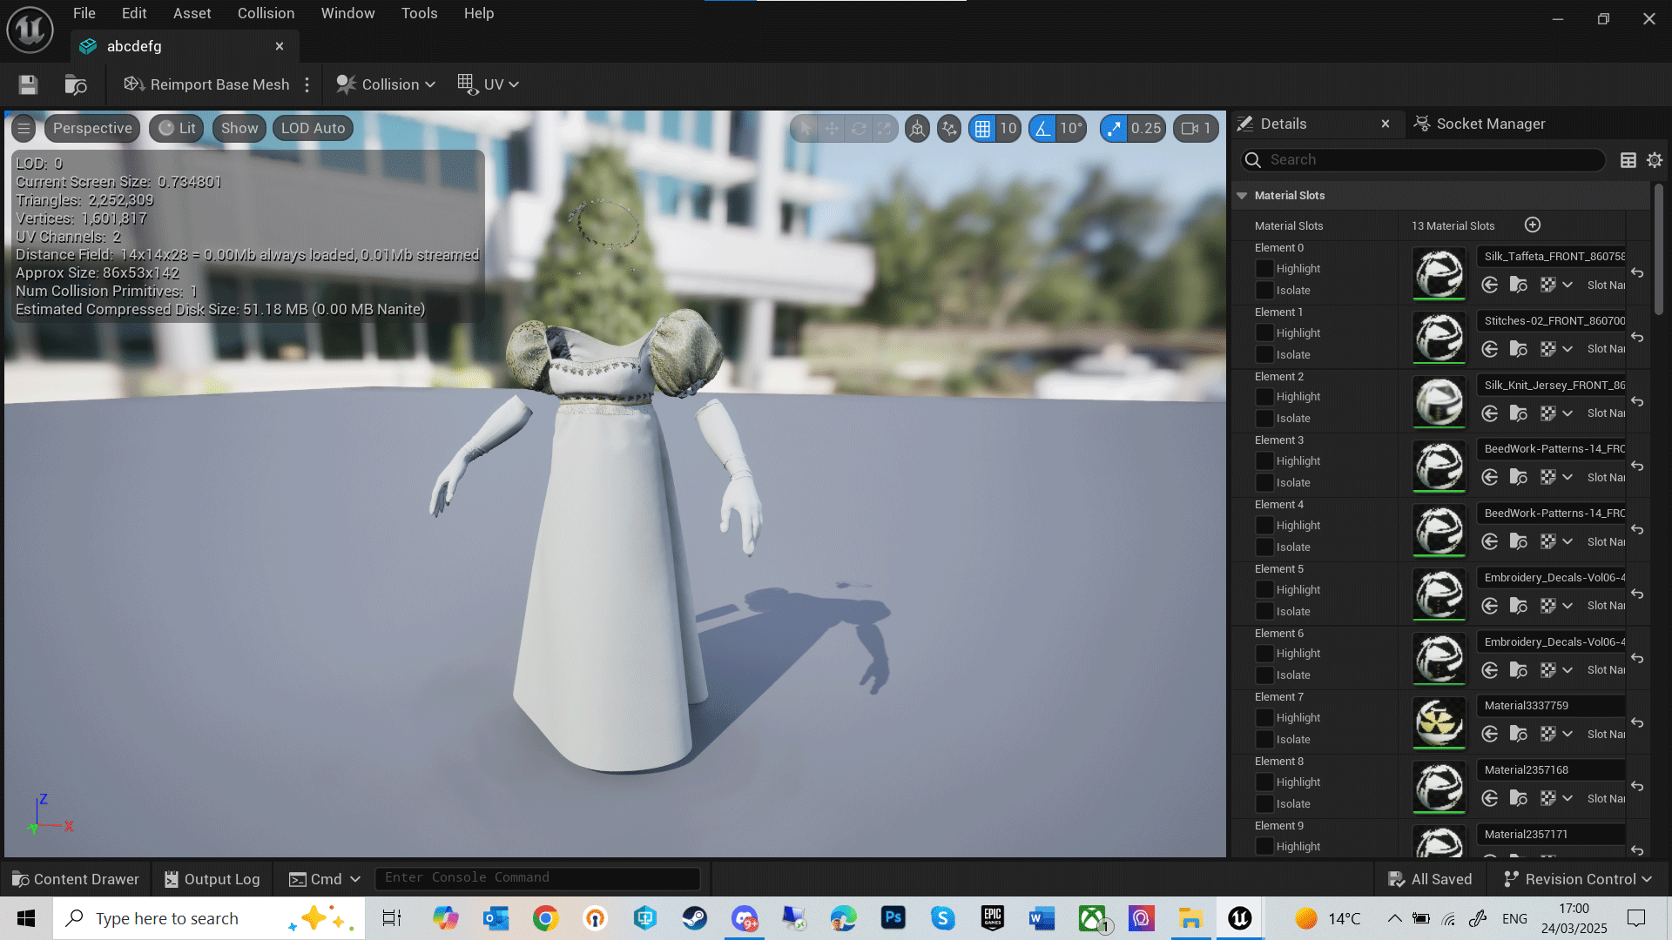
clothes & hair 3D assets

Slide 15
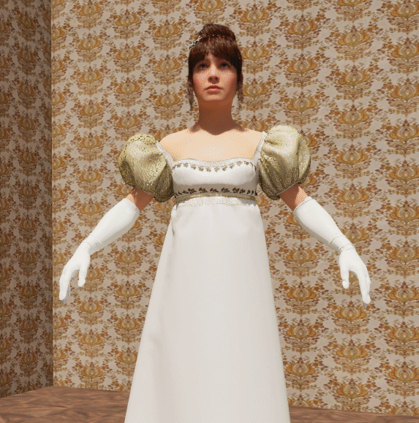
Lit 3D scene with background

Slide 16
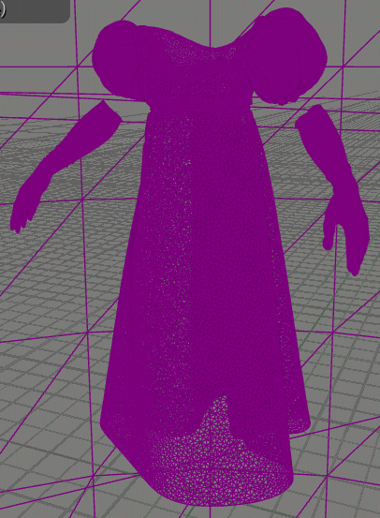
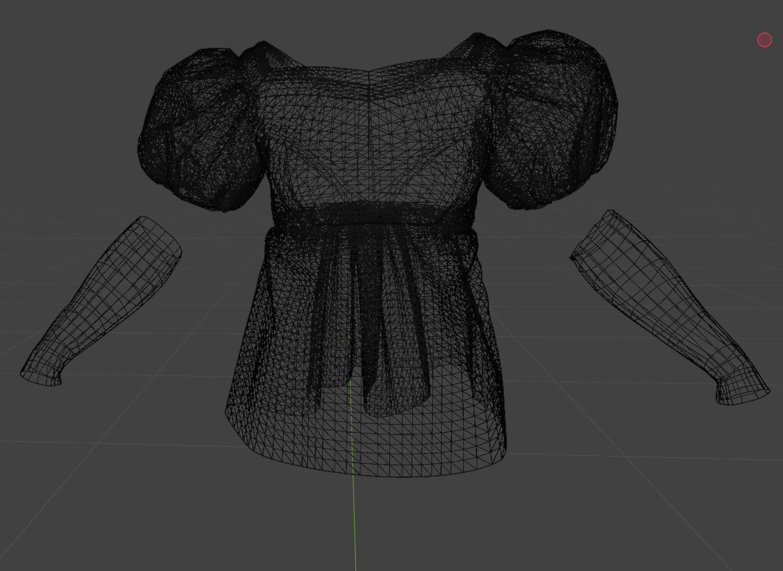
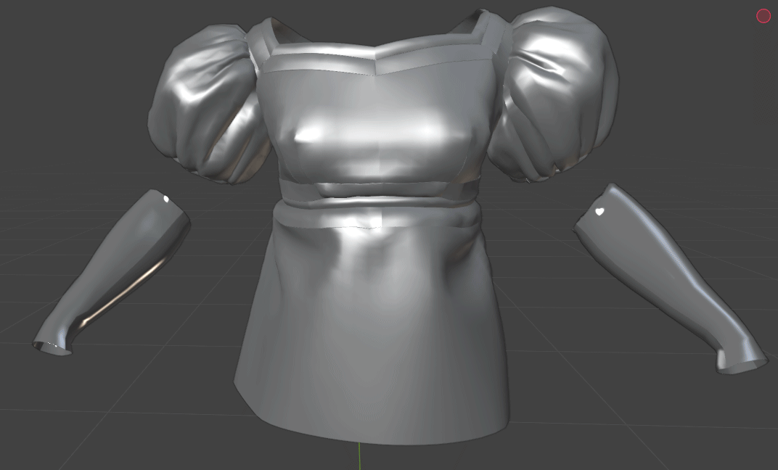
Dress polycount optimisation
85k triangles
5m triangles

Slide 17
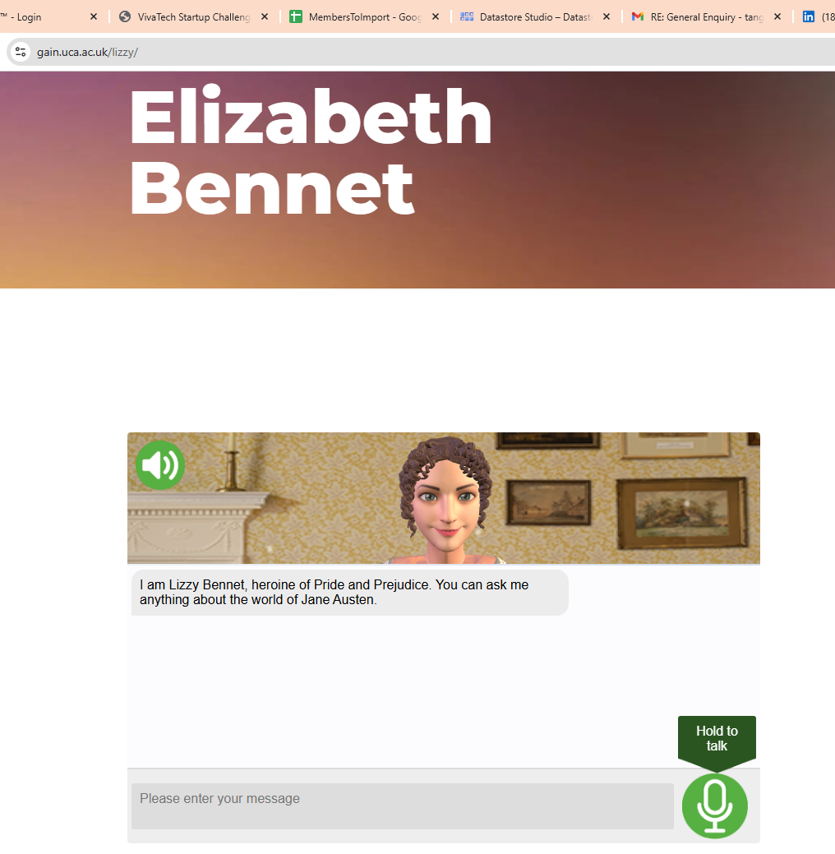
Web-browser avatar

Slide 18
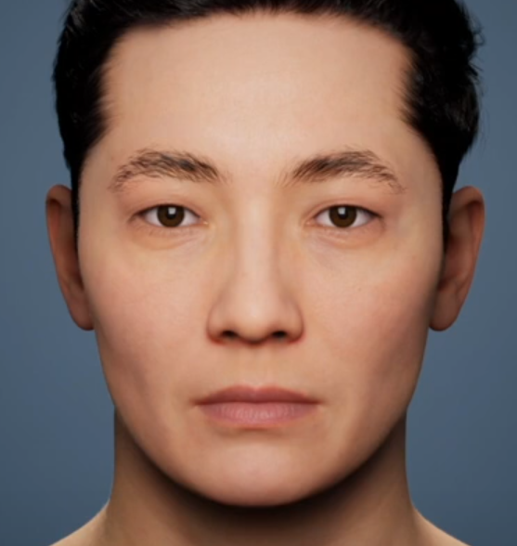
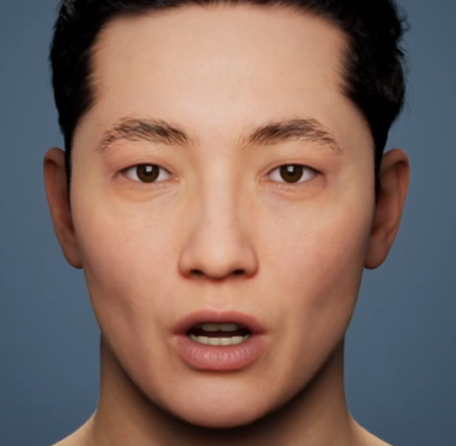
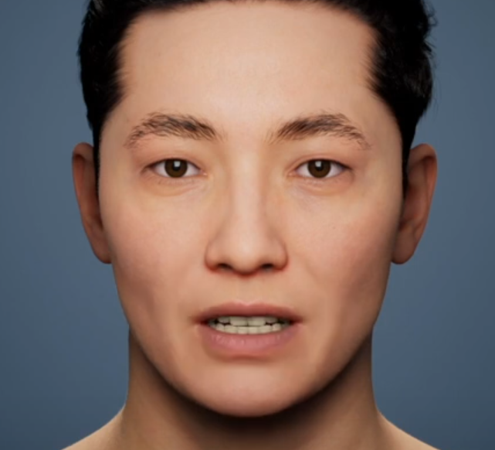
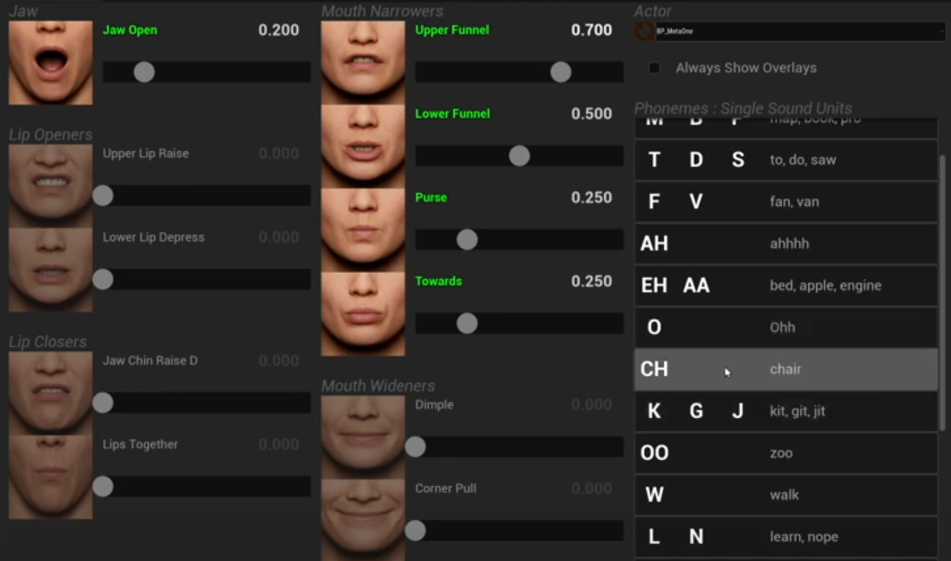
How it works: 3D animations
M
O
T
Each phoneme corresponds to a morph target (AKA blend shape) and jaw position
The speech is converted in real time into a series of keyframes with blend shapes values values from 0 to 100%, to display the right facial expression

Slide 19
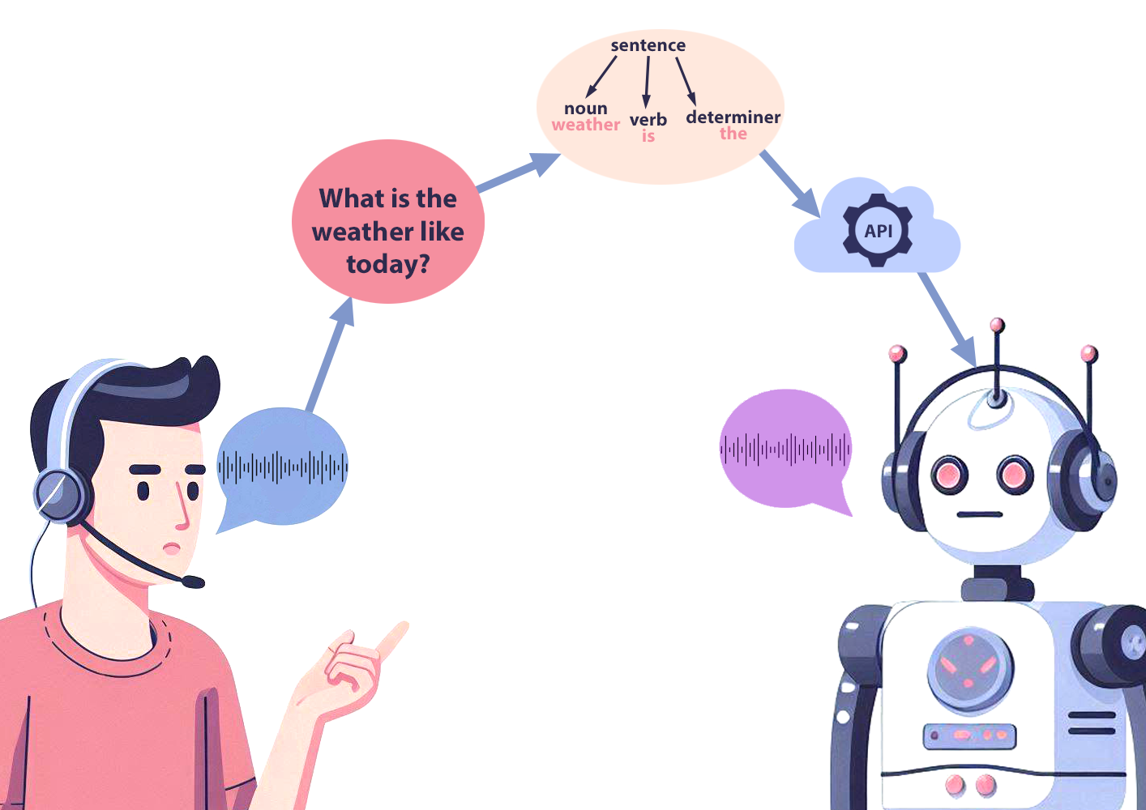
How it works: Audio
Speech-To-Text converts the audio into a written text.
The AI parses the text. It breaks down the sentence structure, identifies keywords, and determines the context.
Using probabilistic modeling, it predicts the most appropriate response.
The text is then converted back into speech with Text-To-Speech

Slide 20
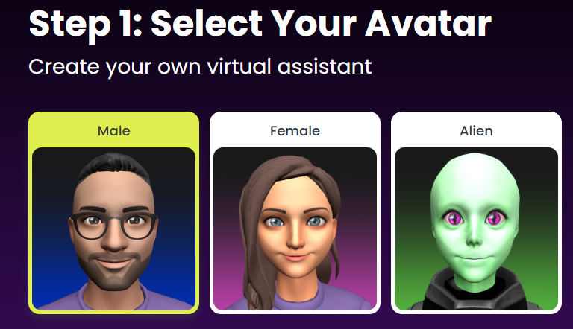

Get in touch for more info!
https://starpal.ai
tanguy@starpal.ai

